Slide 1
CS 4750 - 5750
Image Processing
TA: Jeff Stokes - jmstokes.nmhu@gmail.com

Slide 2
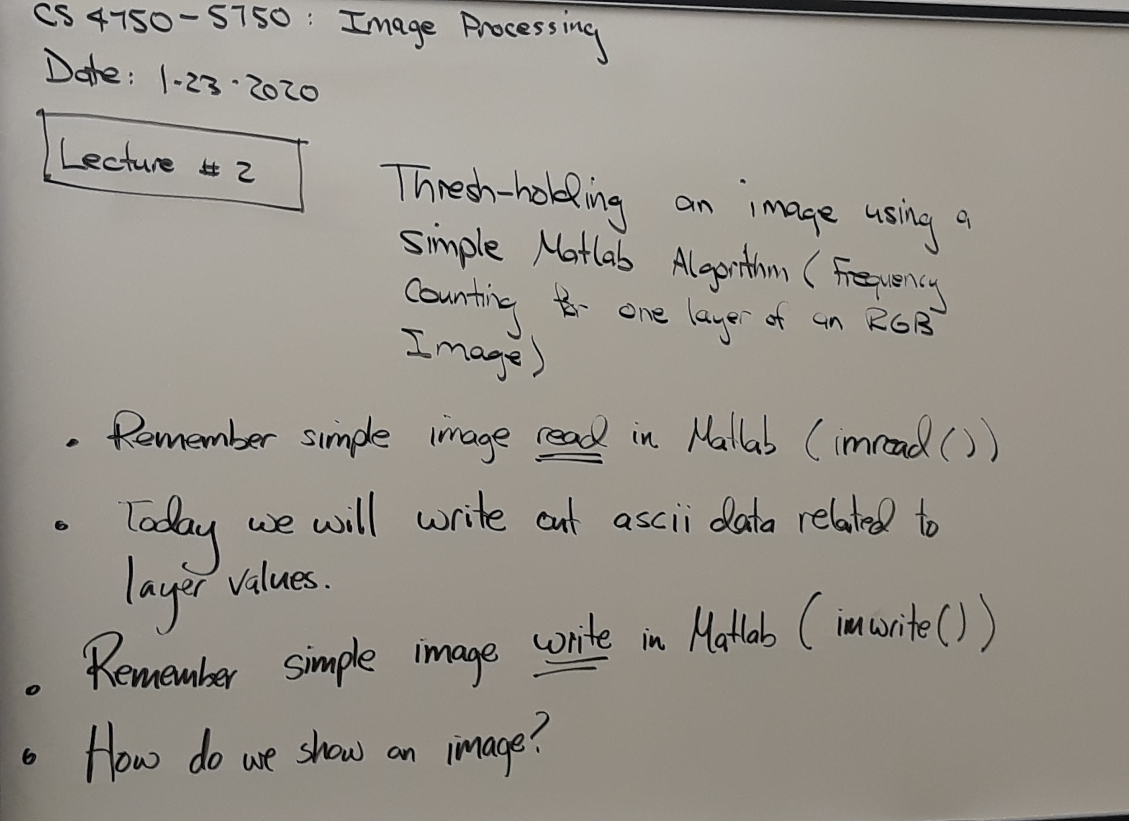
January 23, 2020 - Lecture #2: Part 1

Slide 3
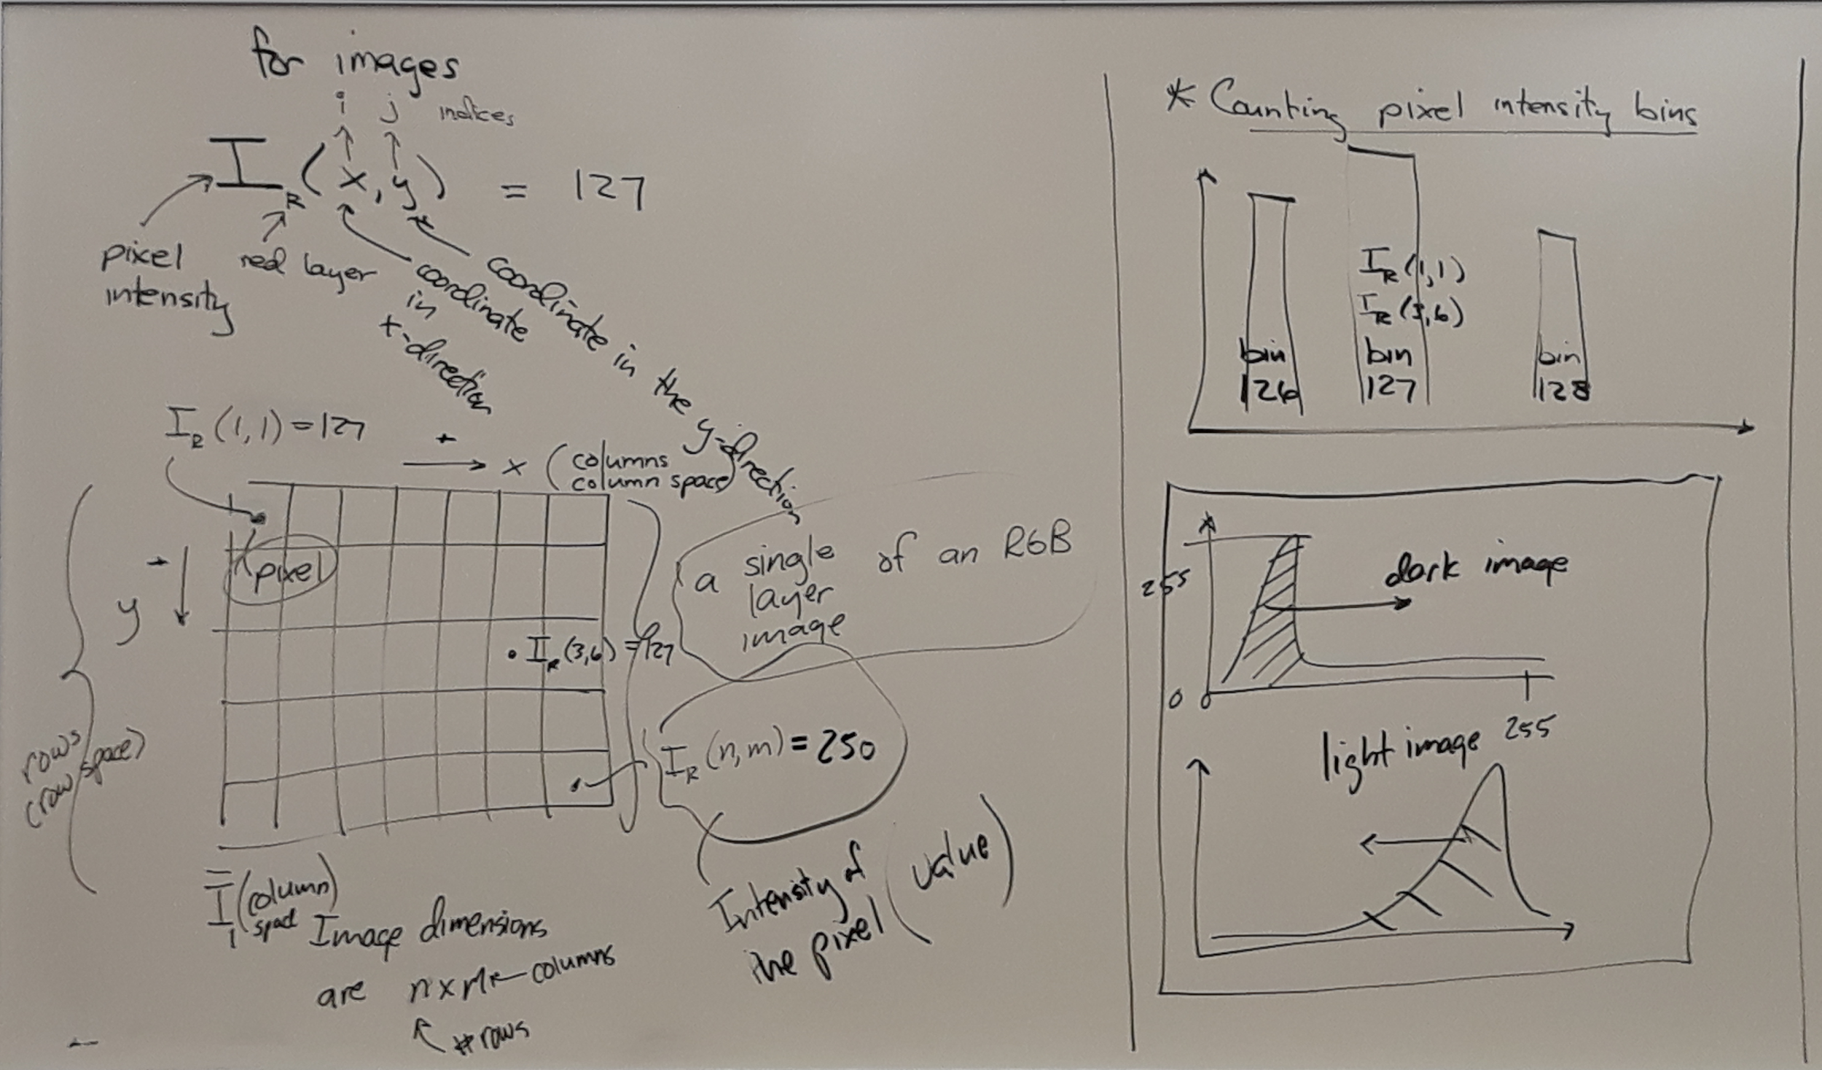
Lecture #2 - Part 2

Slide 4
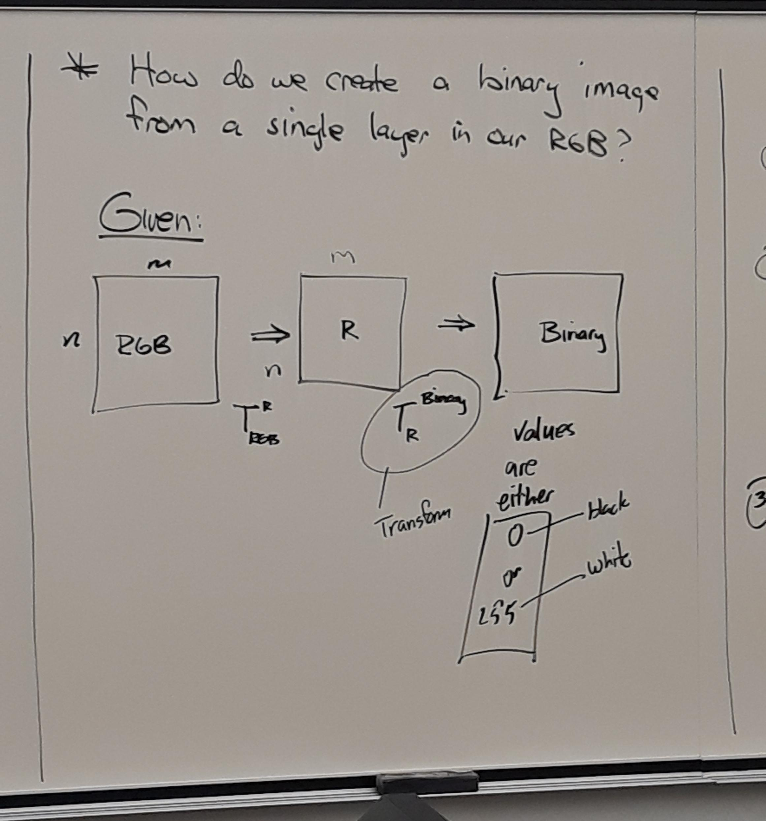
Lecture #2 - Part 3

Slide 5
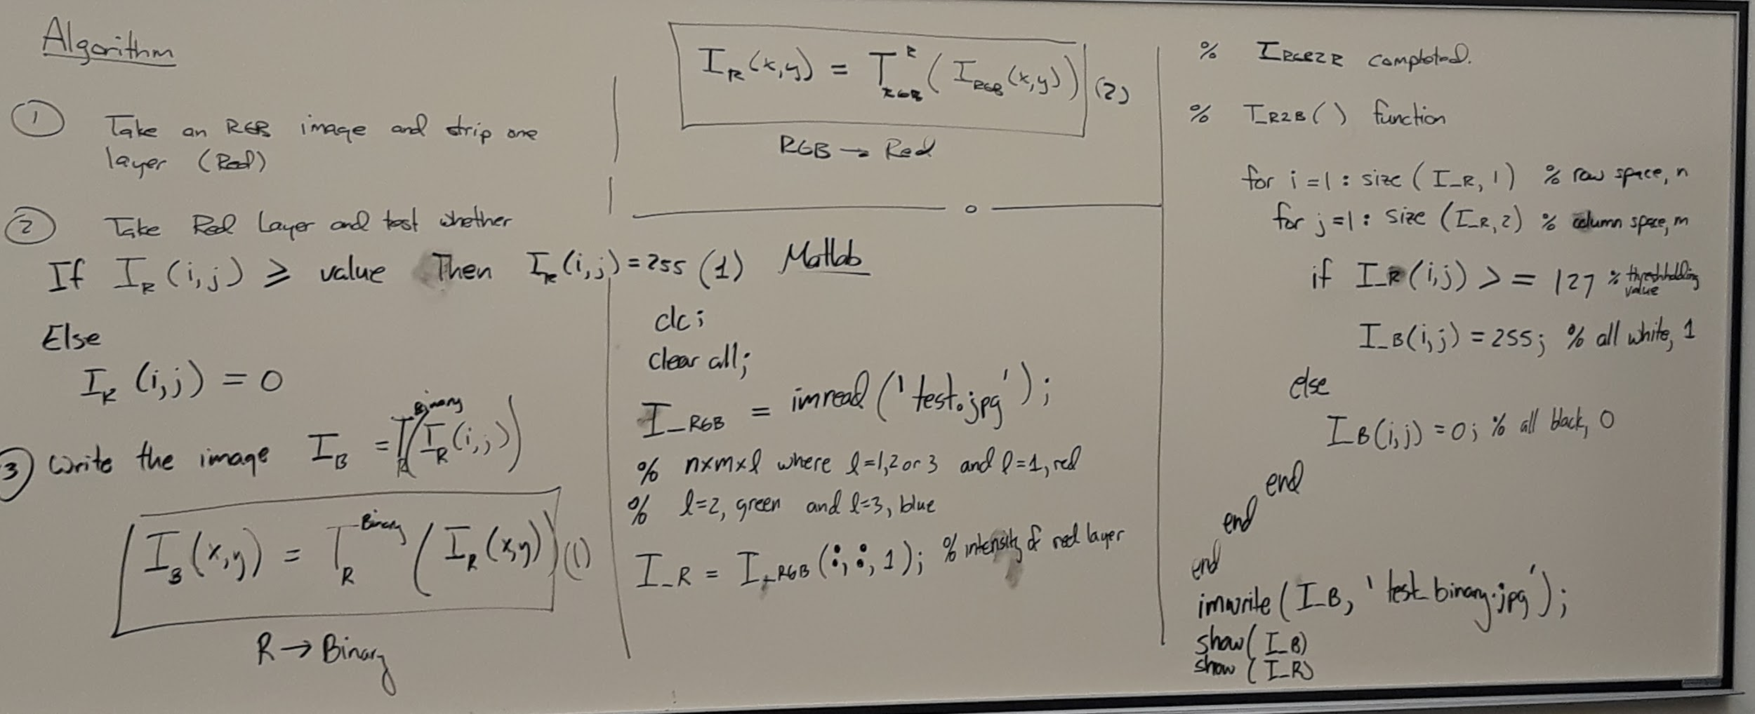
Lecture #2 - Part 4

Slide 6
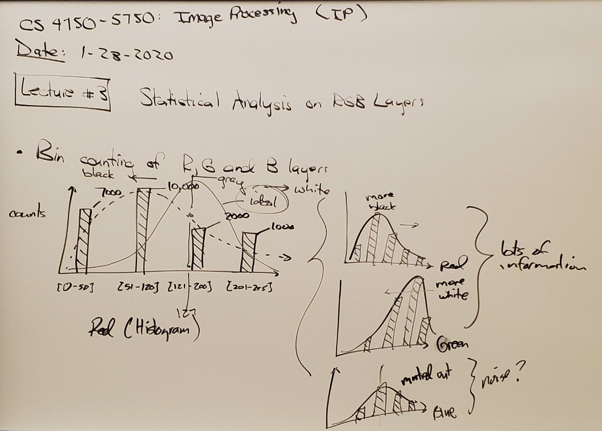
January 28, 2020 - Lecture #3: Part 1

Slide 7
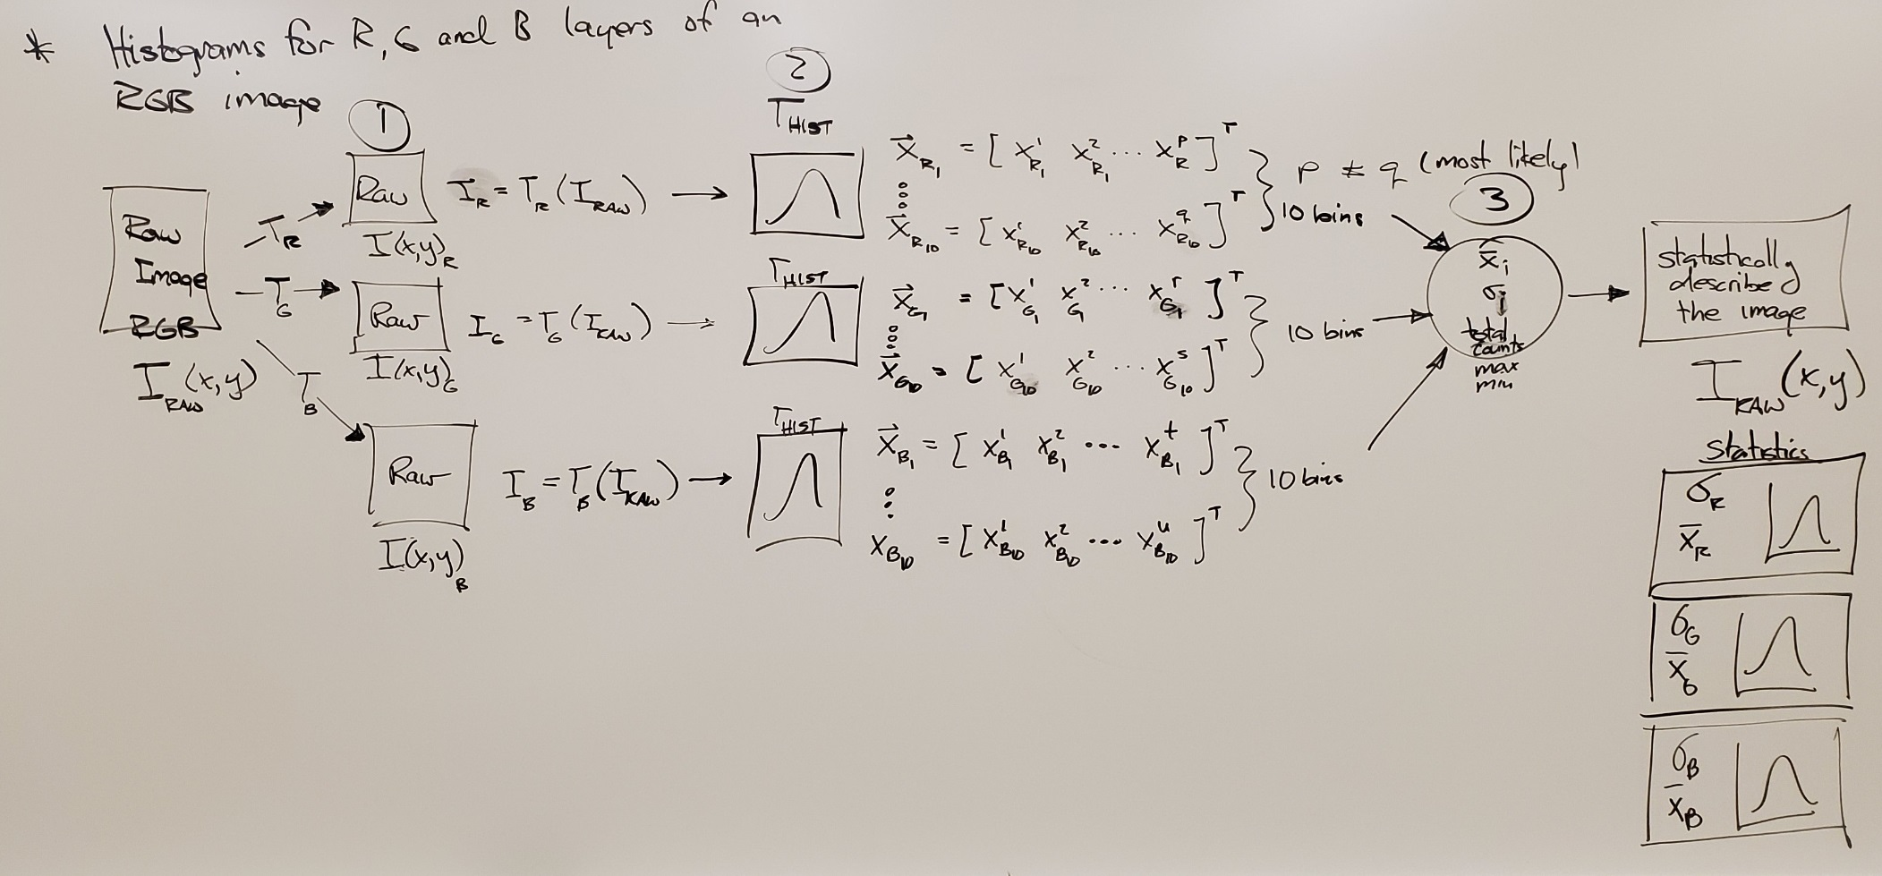
Lecture #3 - Part 2

Slide 8
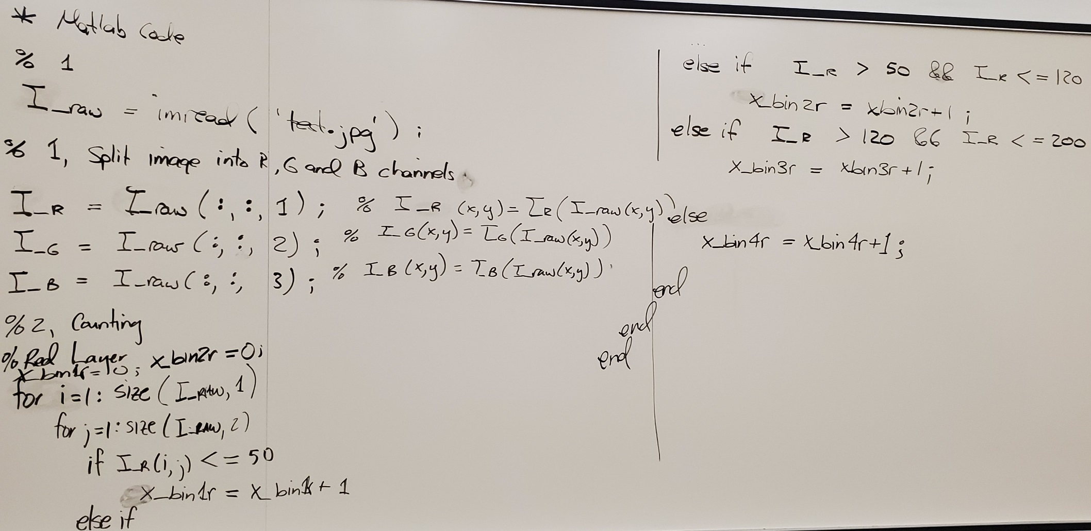
Lecture #3 - Part 3

Slide 9
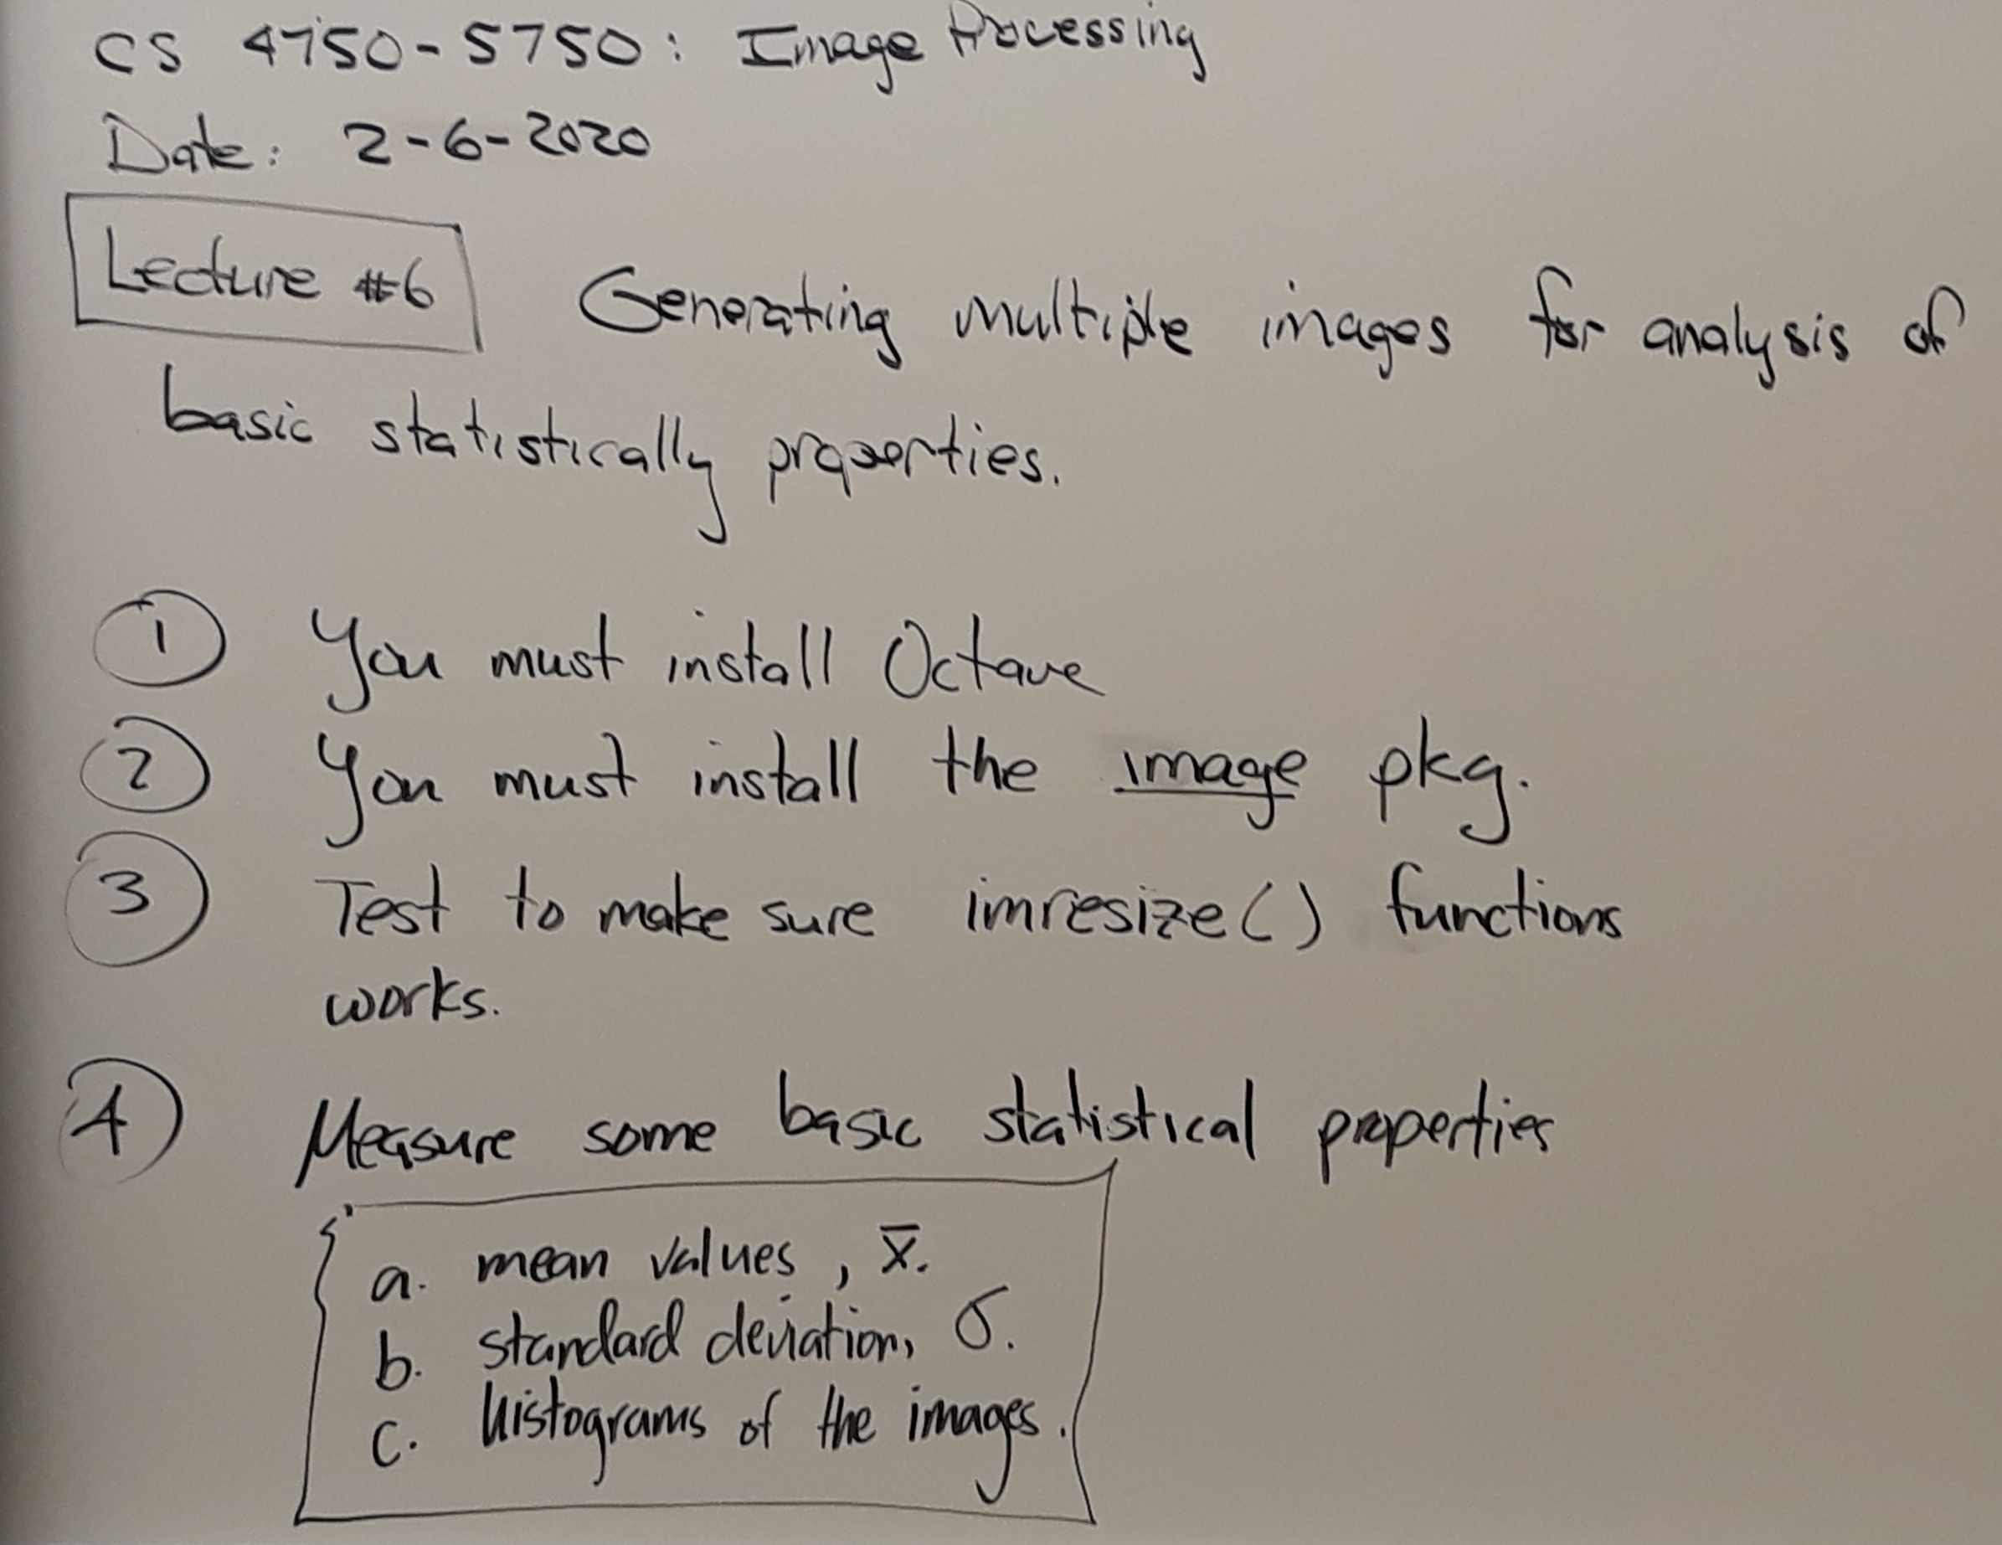
Lecture #6 - 02/06/2020 (Encompasses lectures 4&5)

Slide 10
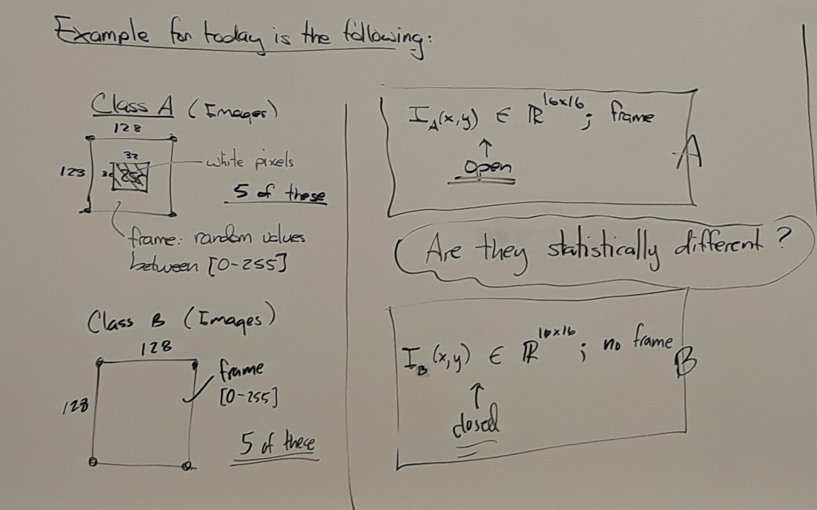
Lecture #6 - Part 2

Slide 11
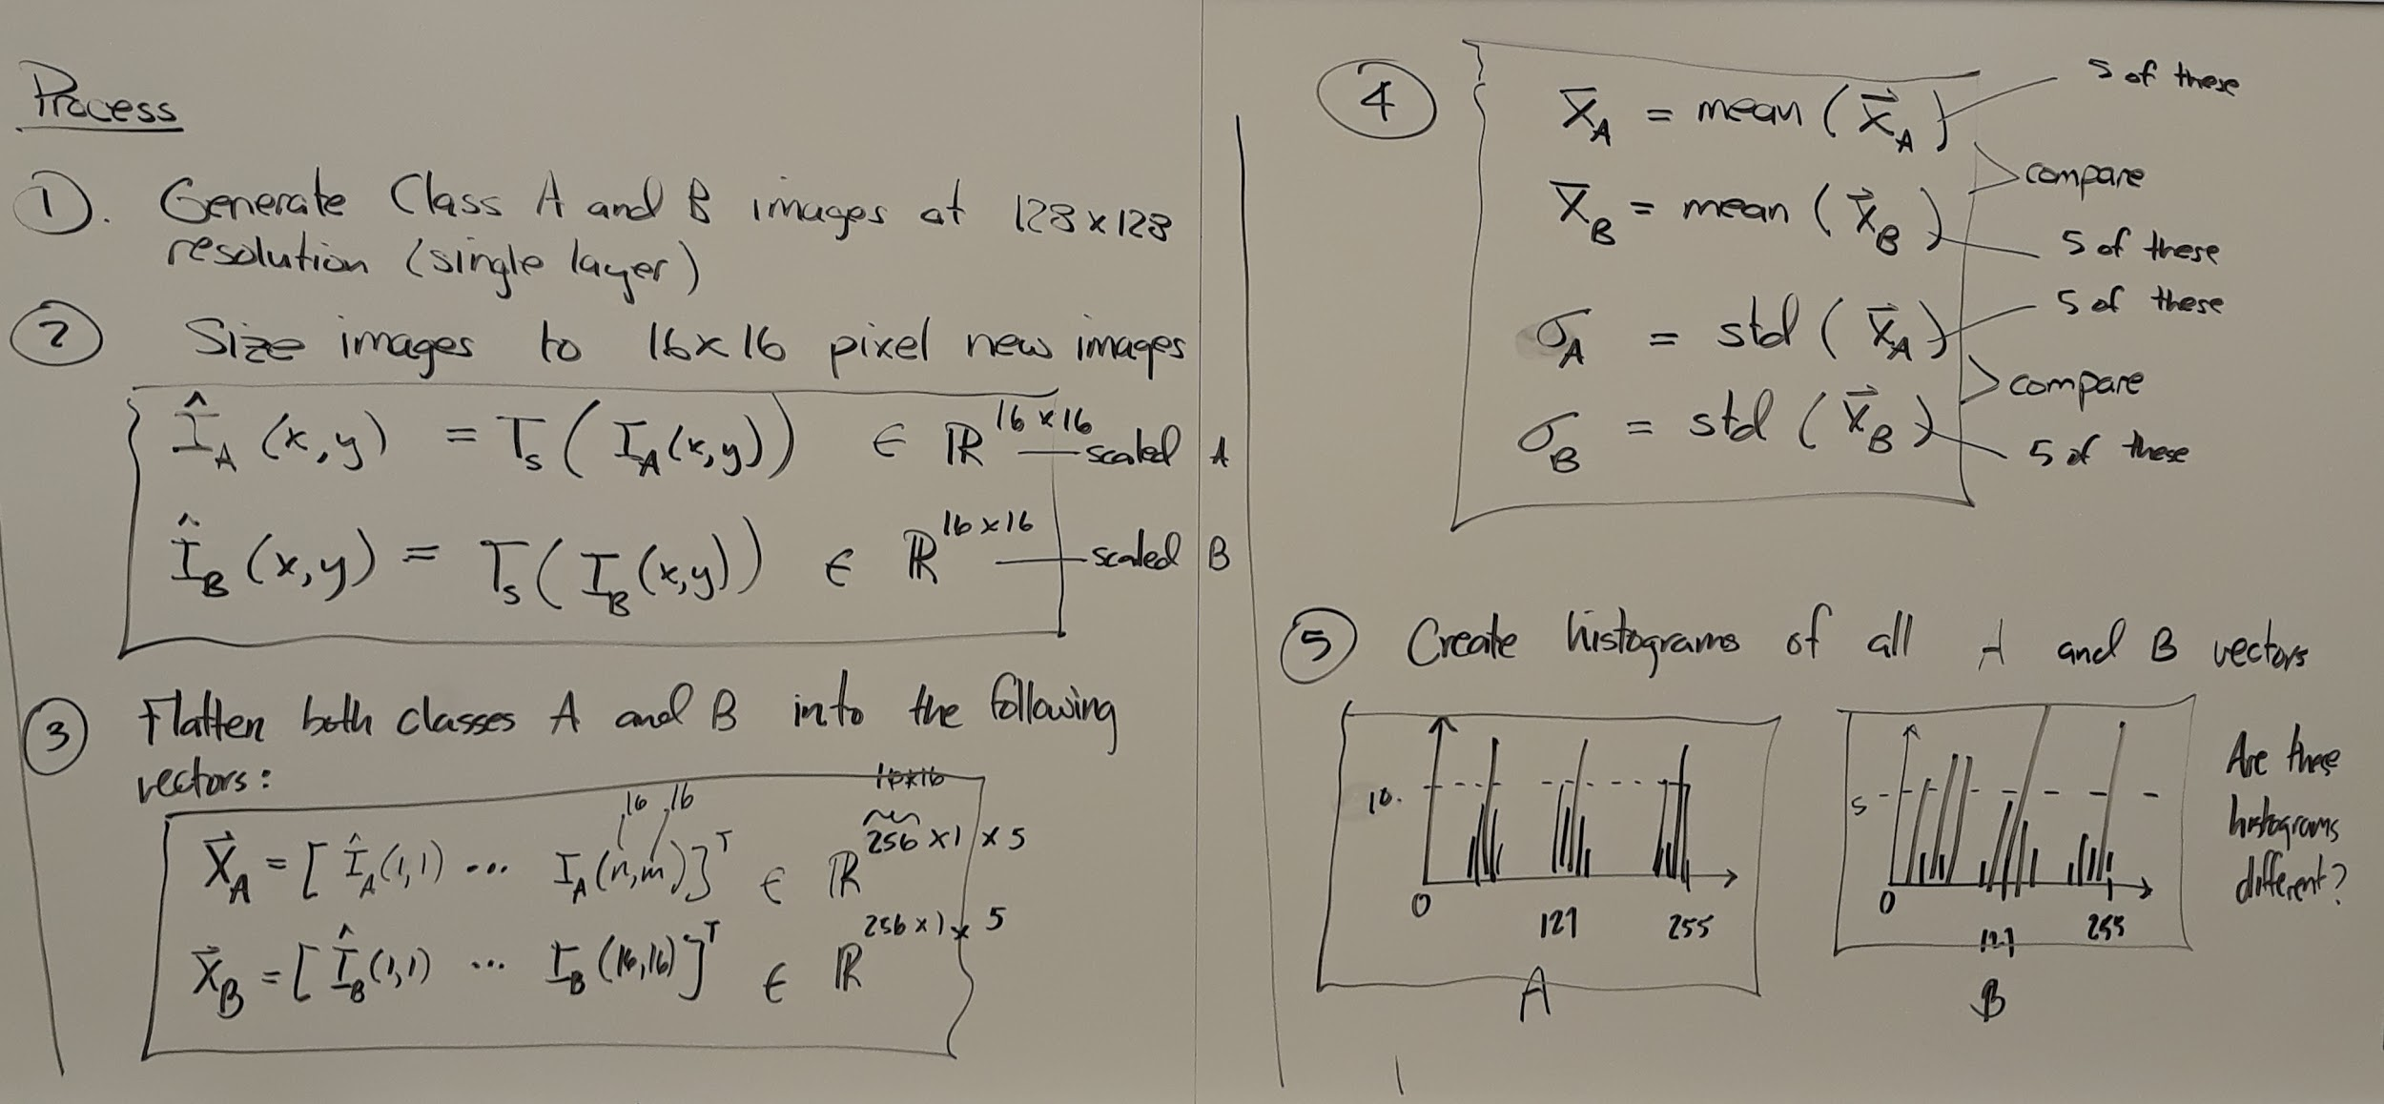
Lecture #6 - Part 3

Slide 12
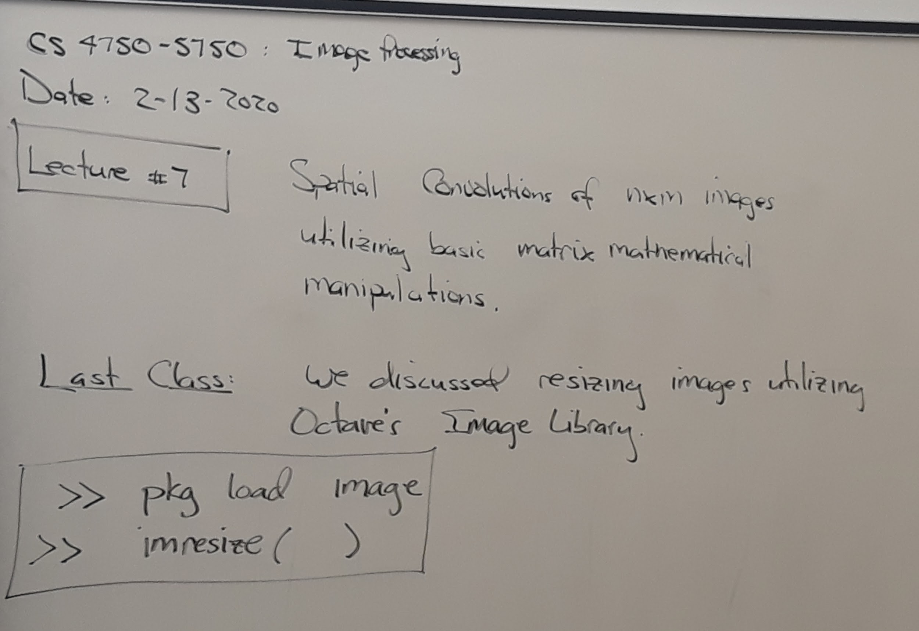
Lecture #7 - 02/13/2020

Slide 13
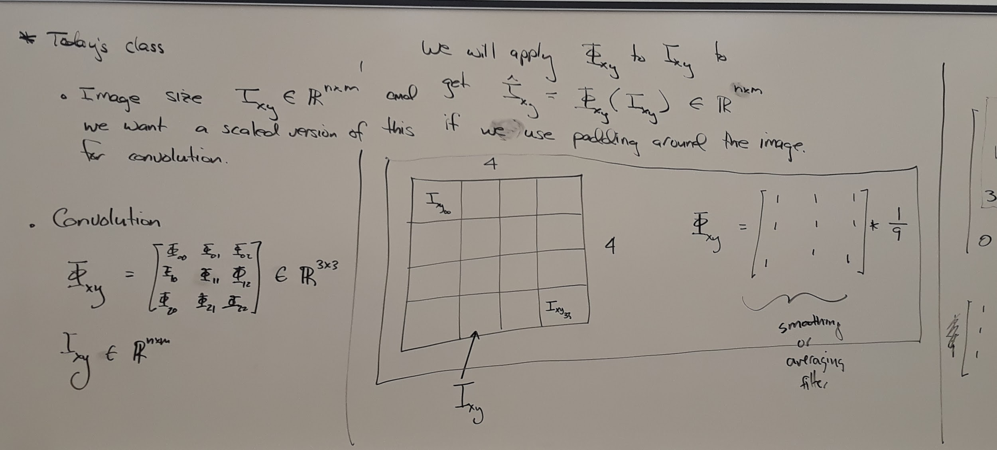
Lecture #7 - Part 2

Slide 14
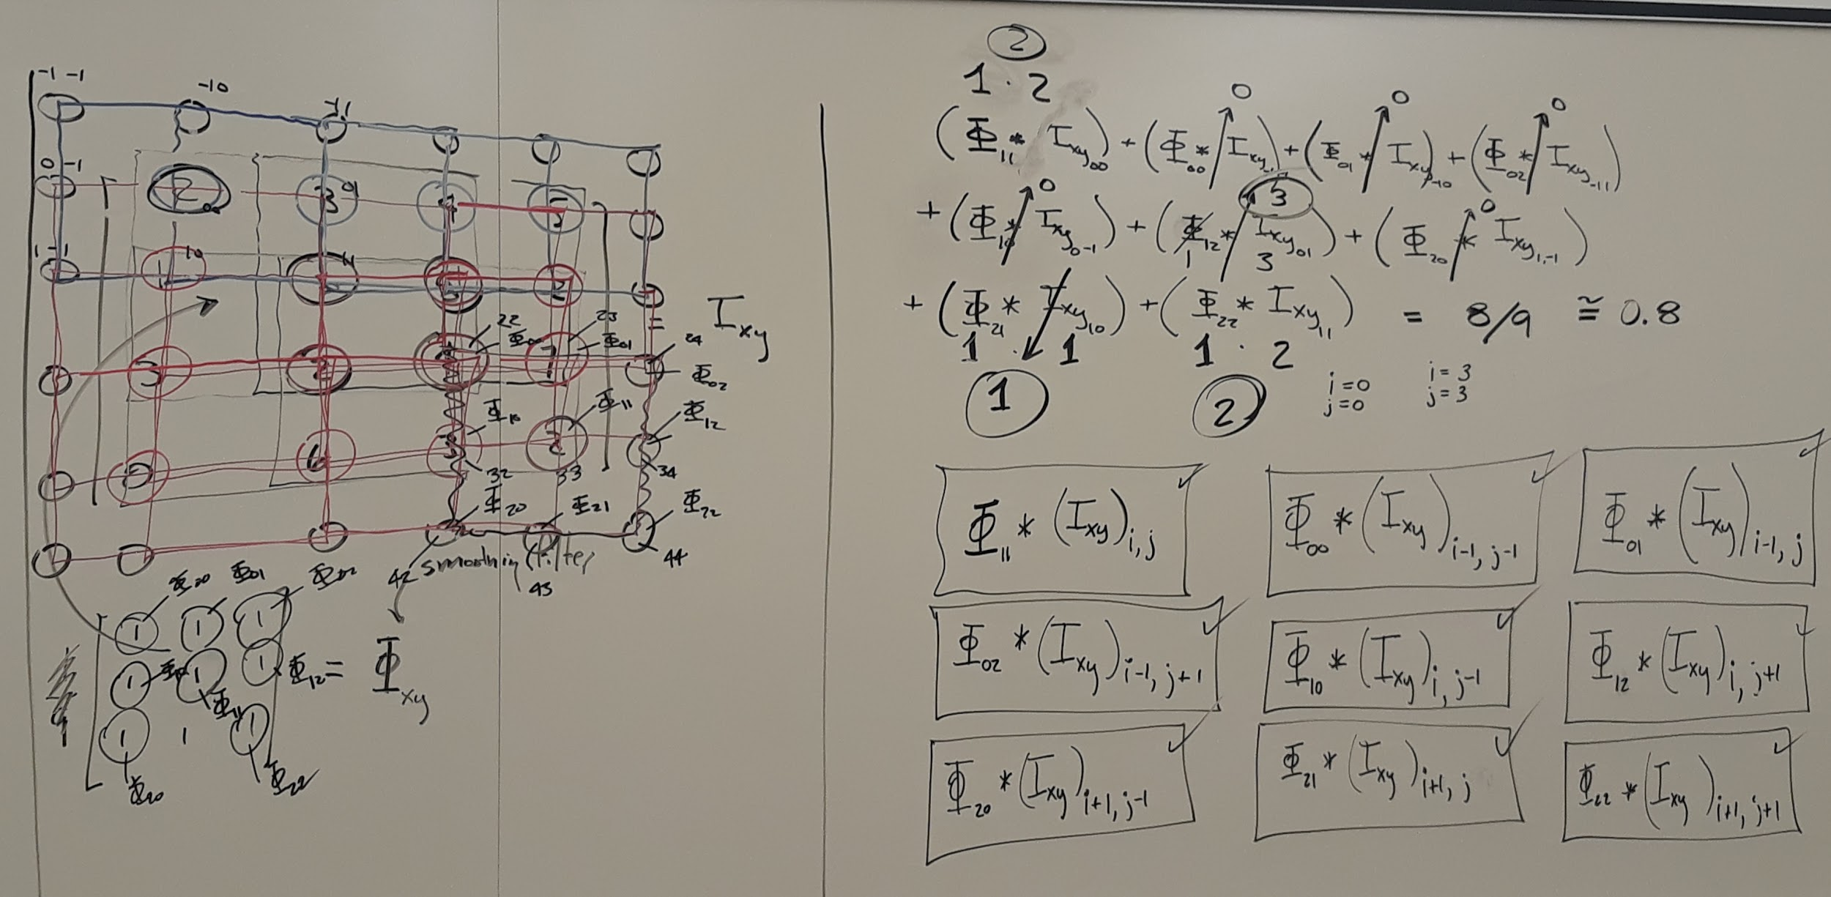
Lecture #7 - Part 3

Slide 15
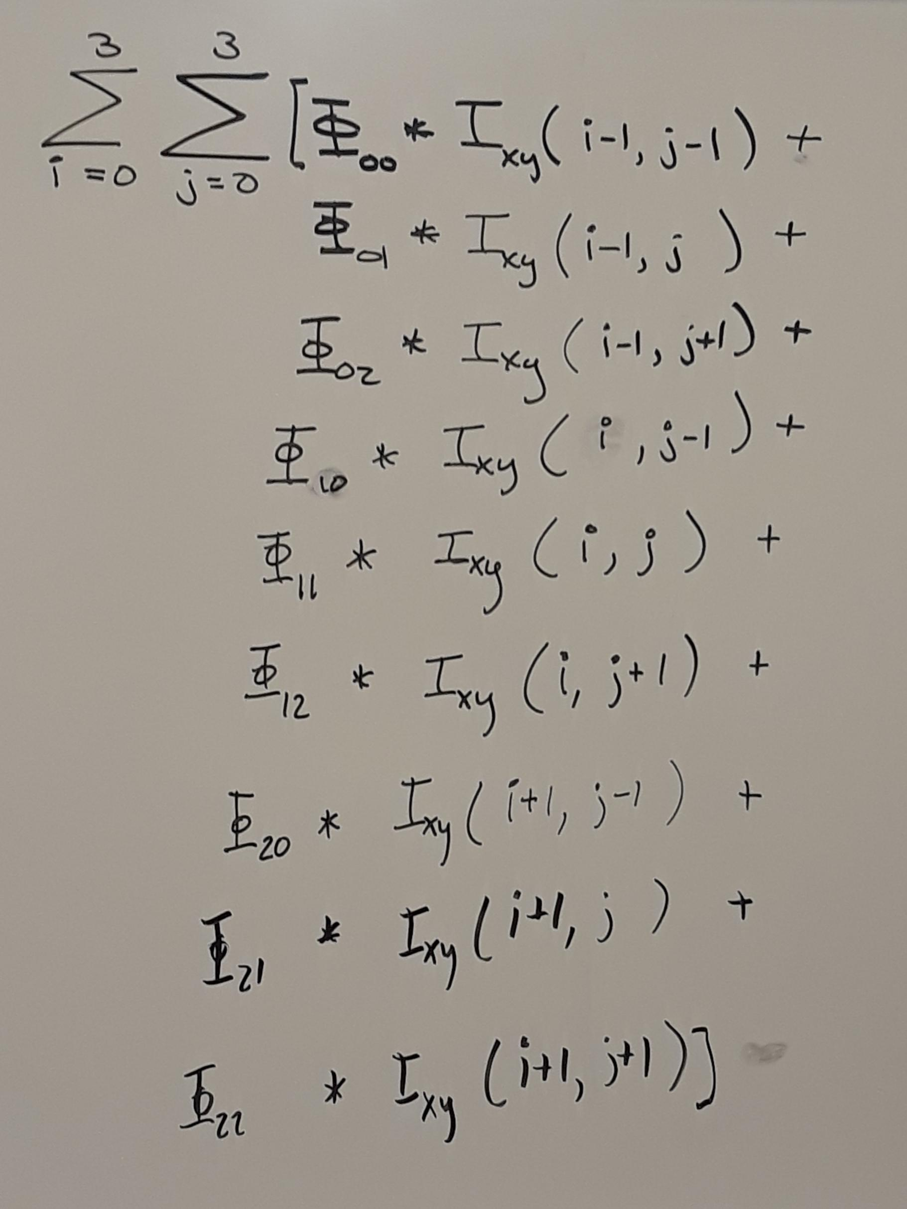
Lecture #7 - Part 4

Slide 16
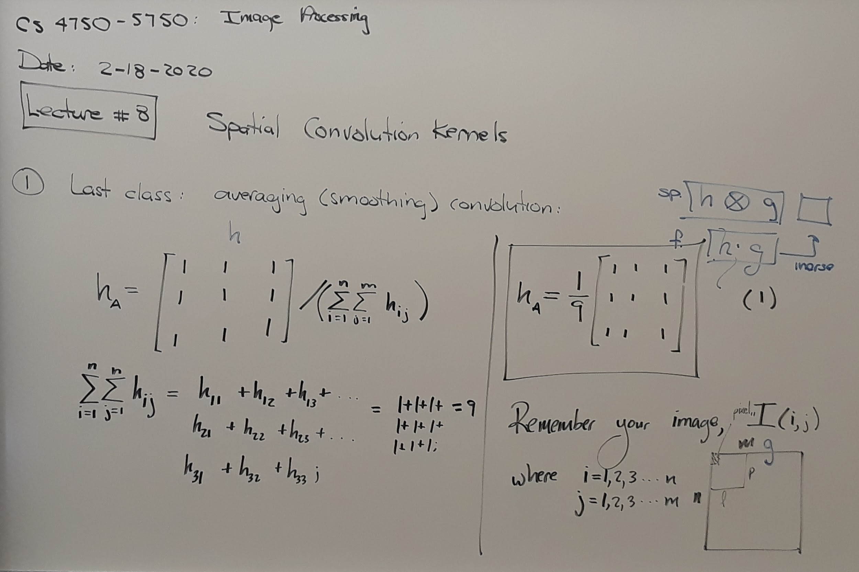
Lecture #8 - 02/18/2020

Slide 17
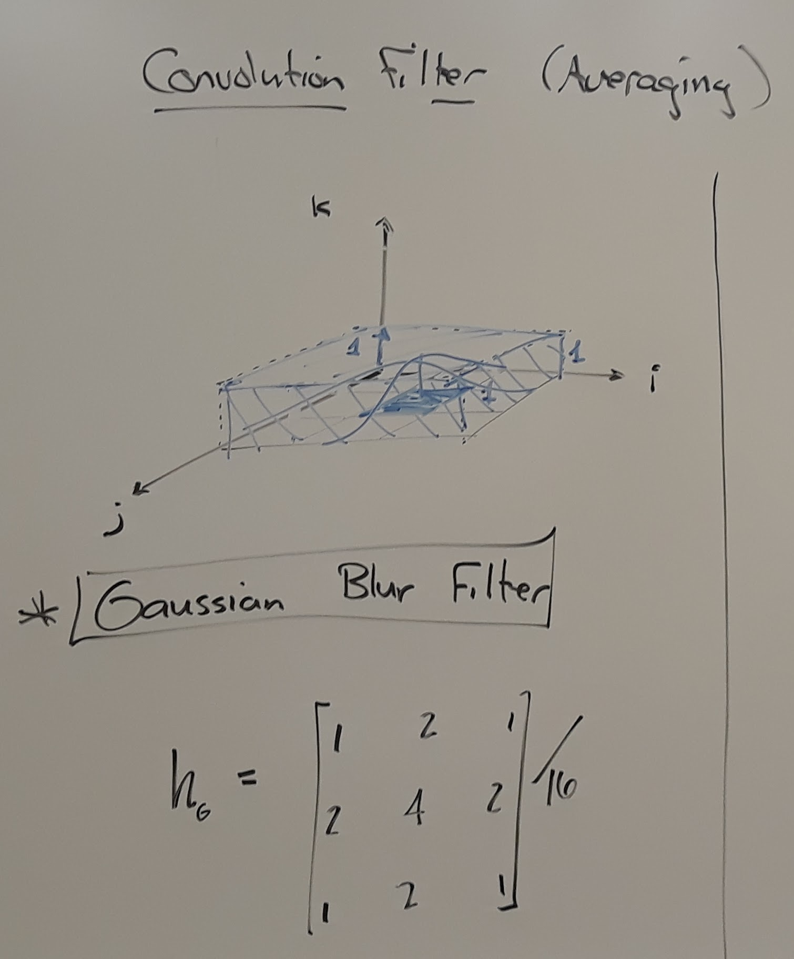
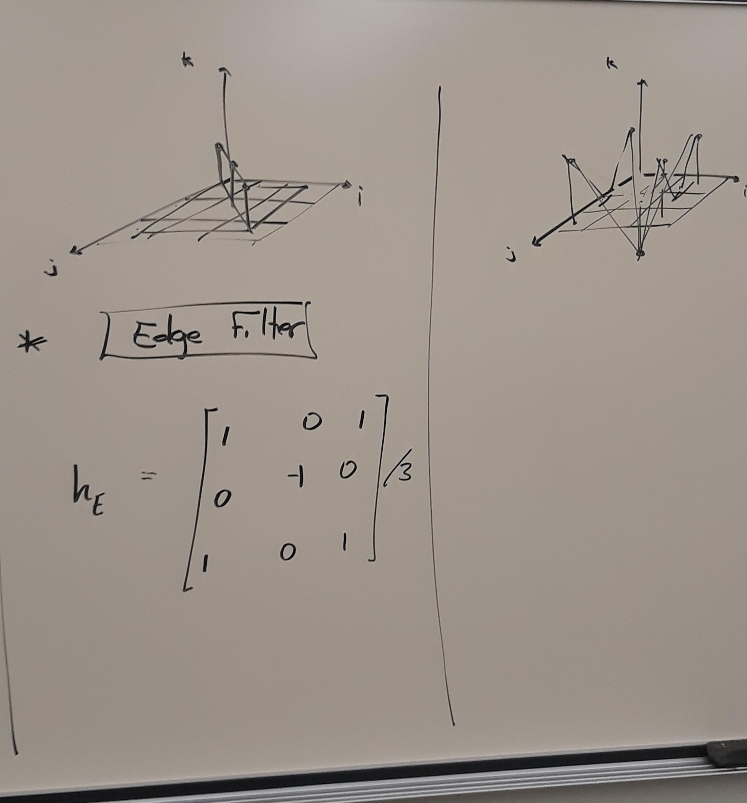
Lecture #8 - Part 2

Slide 18
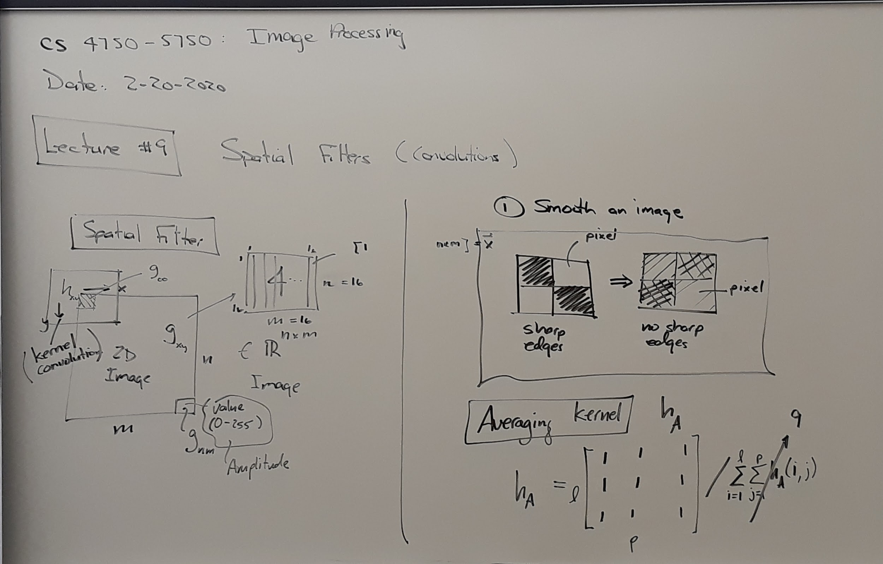
Lecture #9 - 02/20/2020

Slide 19
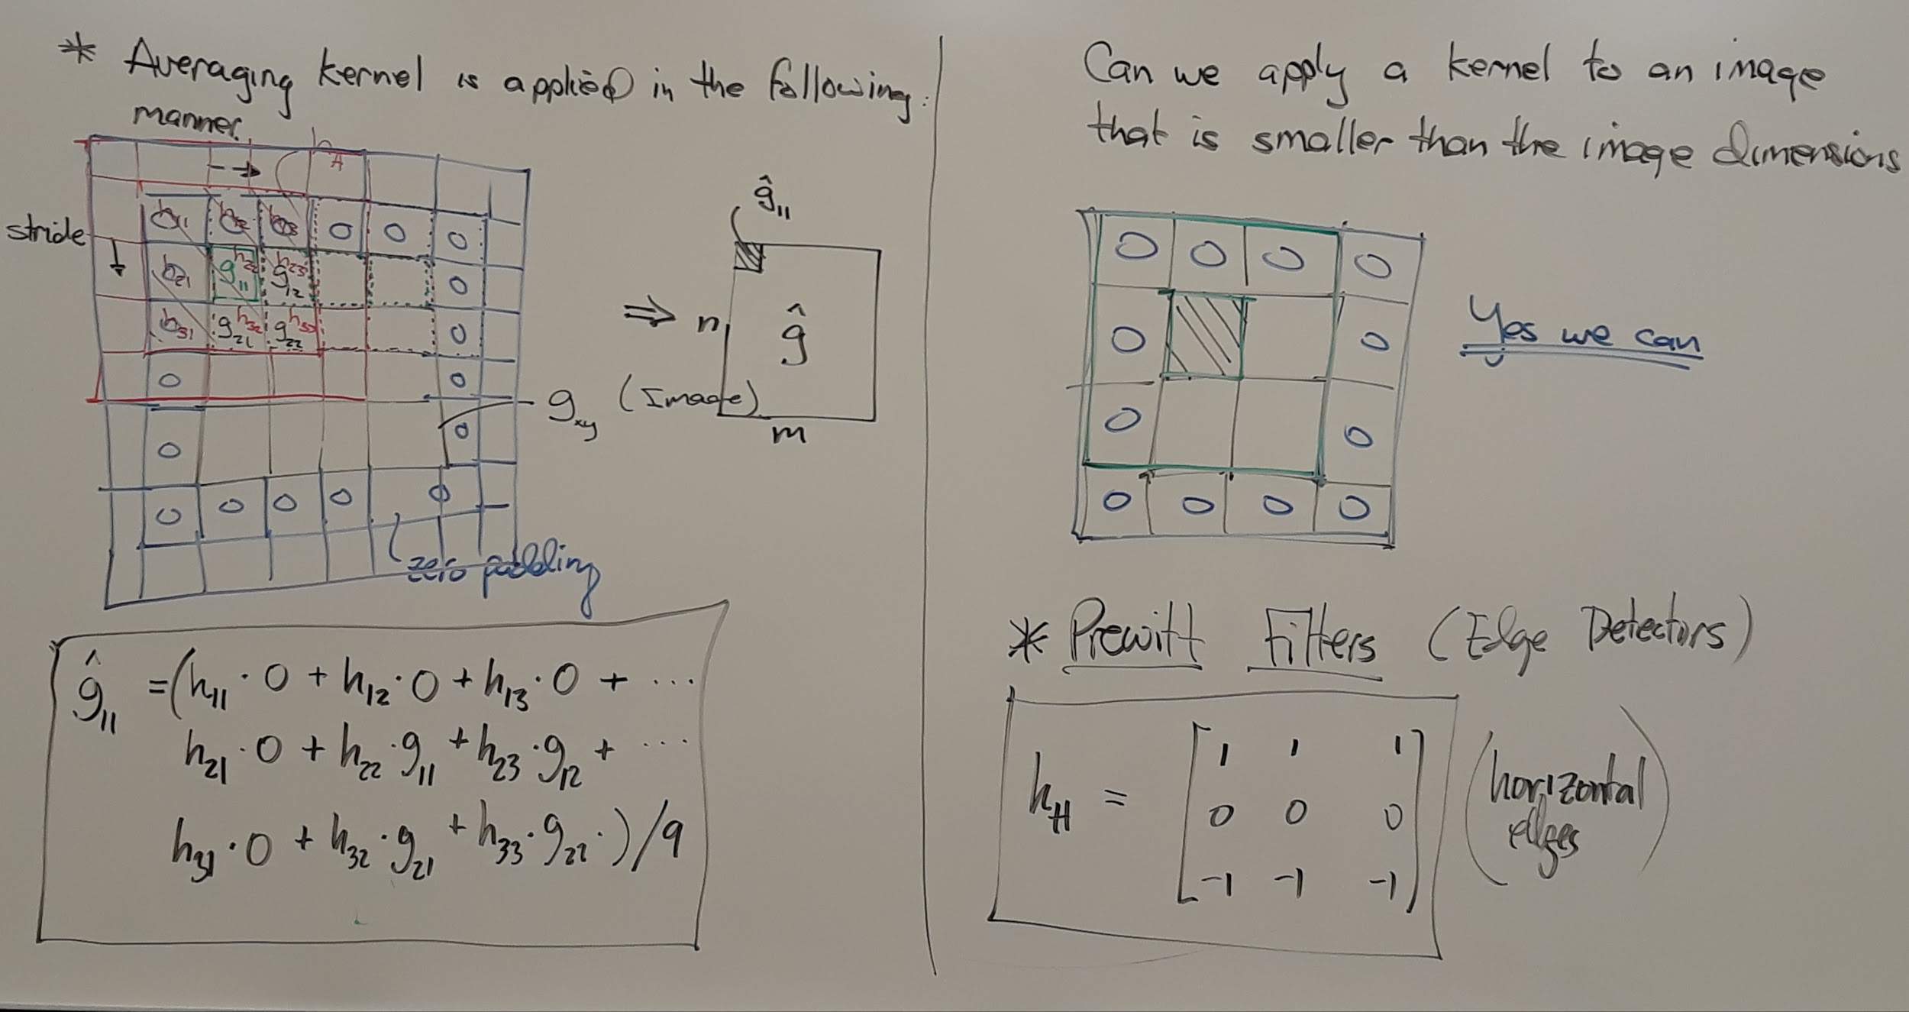
Lecture #9 - Part 2

Slide 20
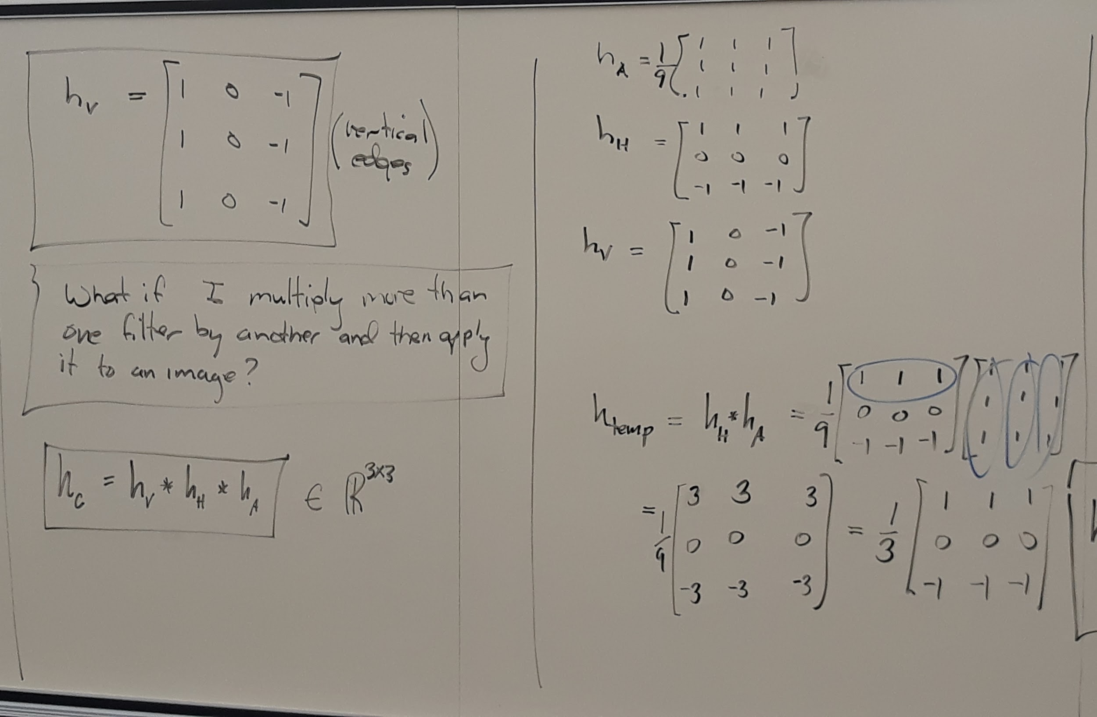
Lecture #9 - Part 3

Slide 21
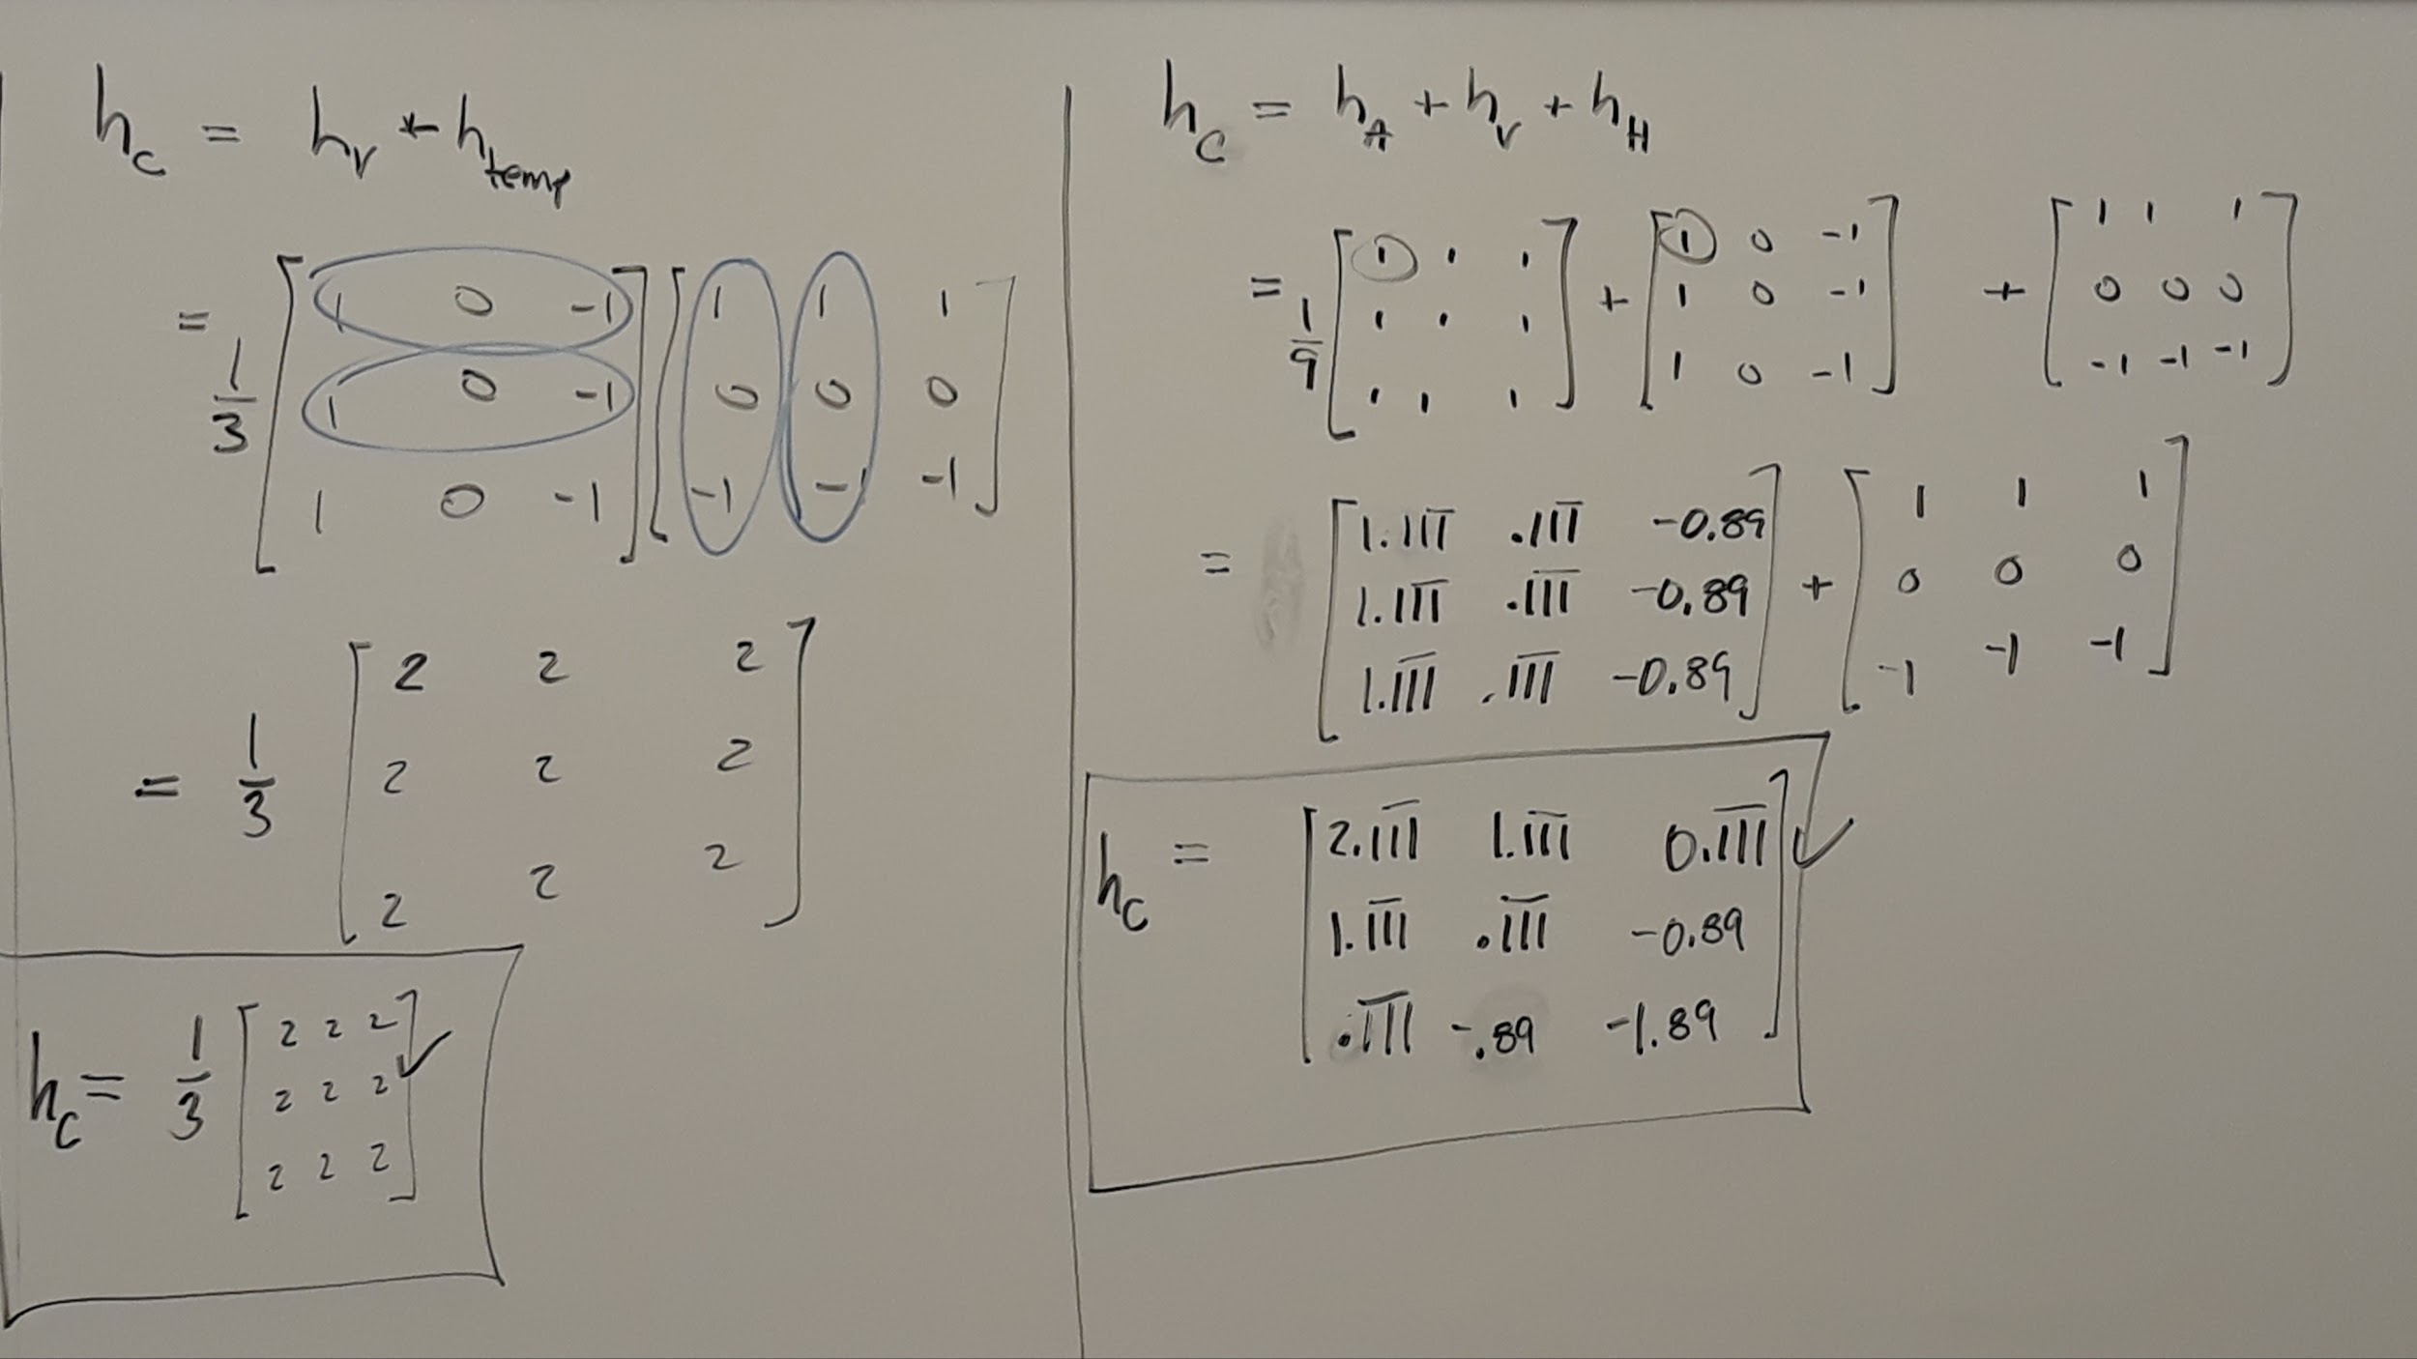
Lecture #9 - Part 4

Slide 22
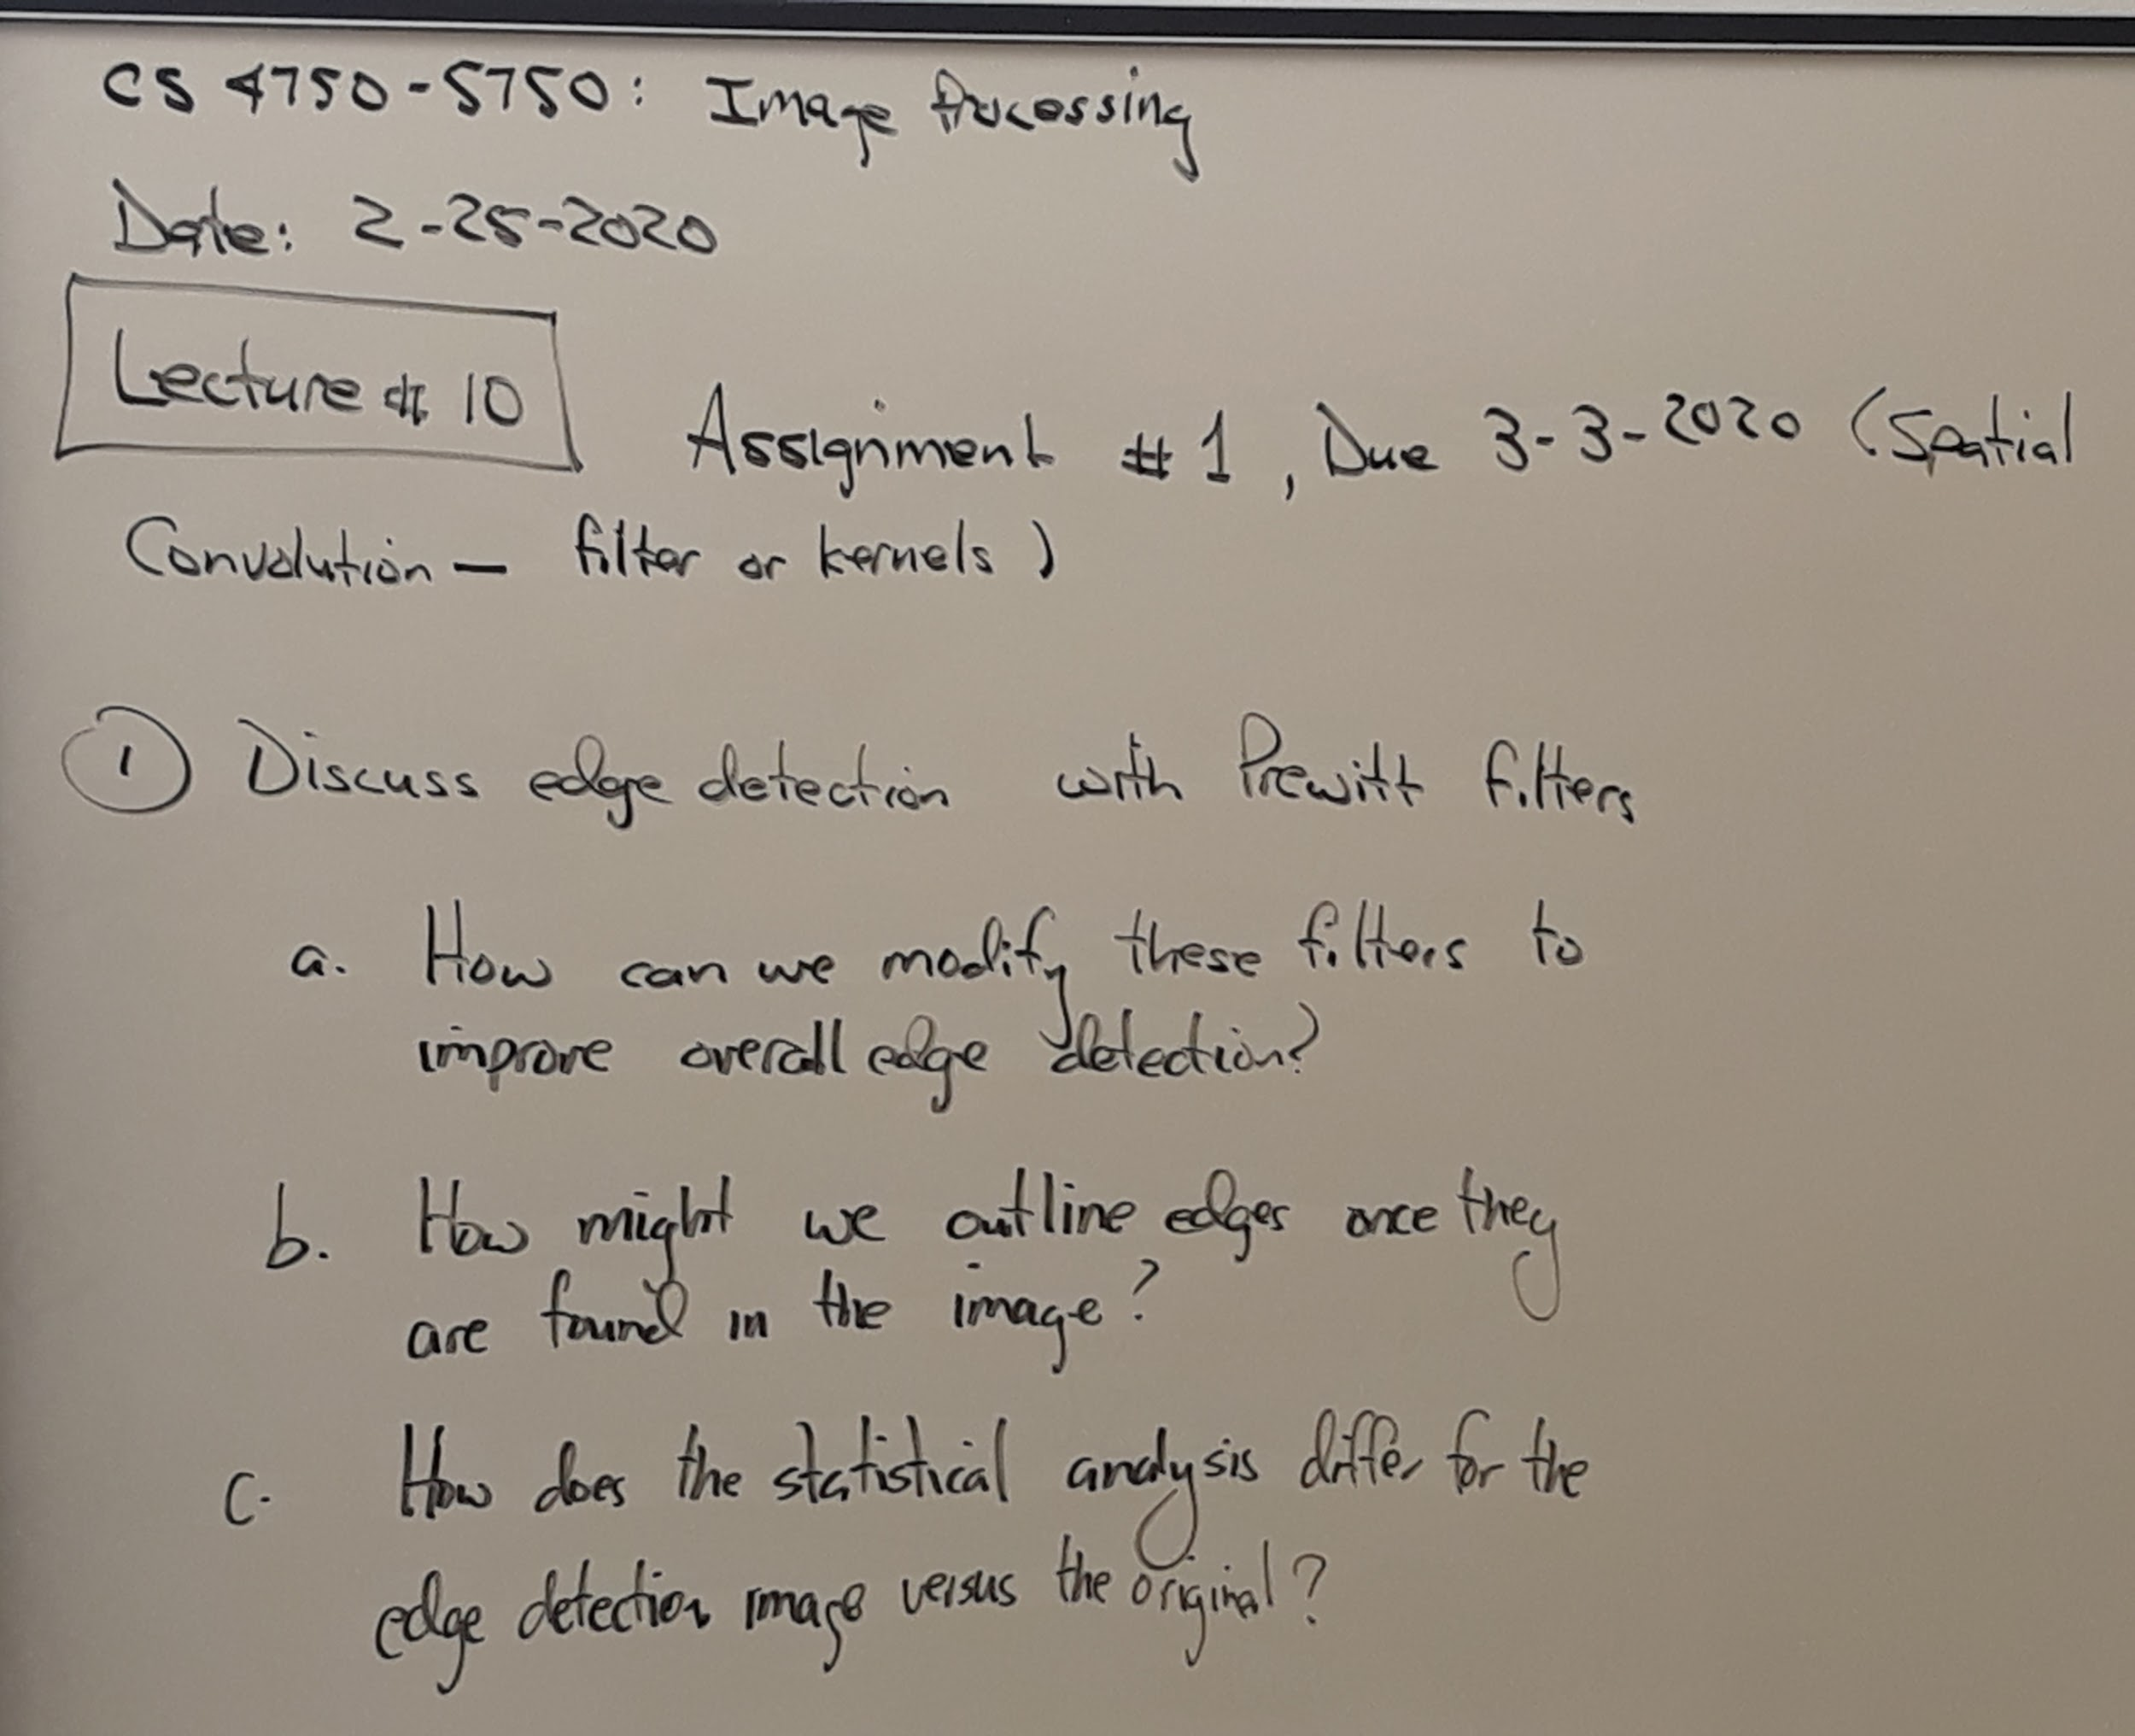
Lecture #10 - 02/25/2020

Slide 23
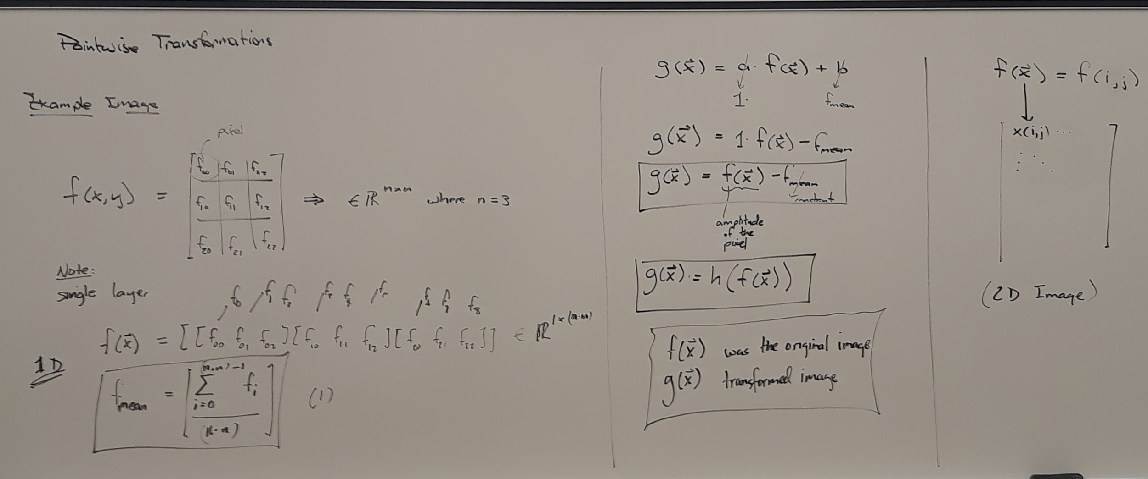
Lecture #10 - Part 2

Slide 24
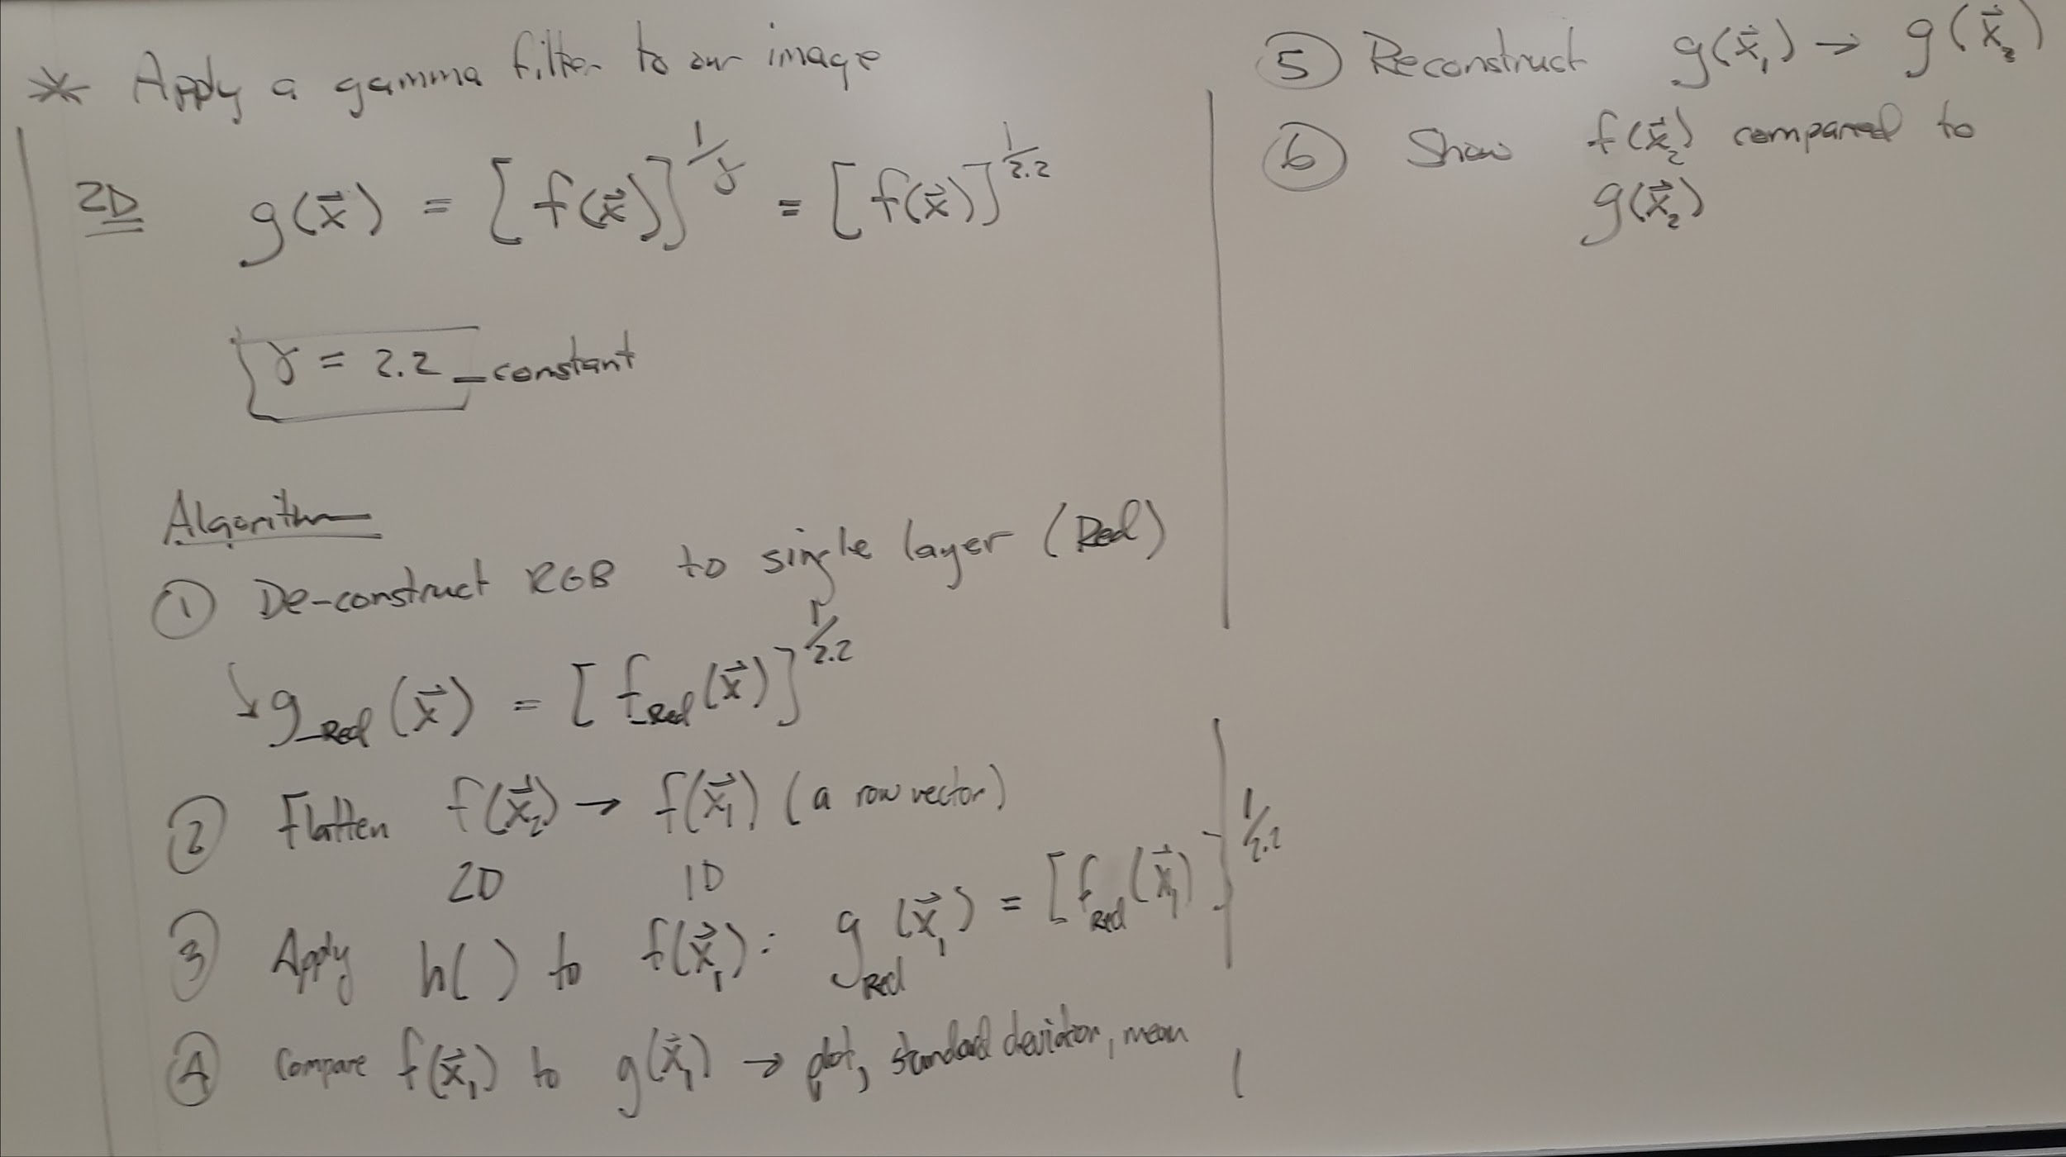
Lecture #10 - Part 3

Slide 25
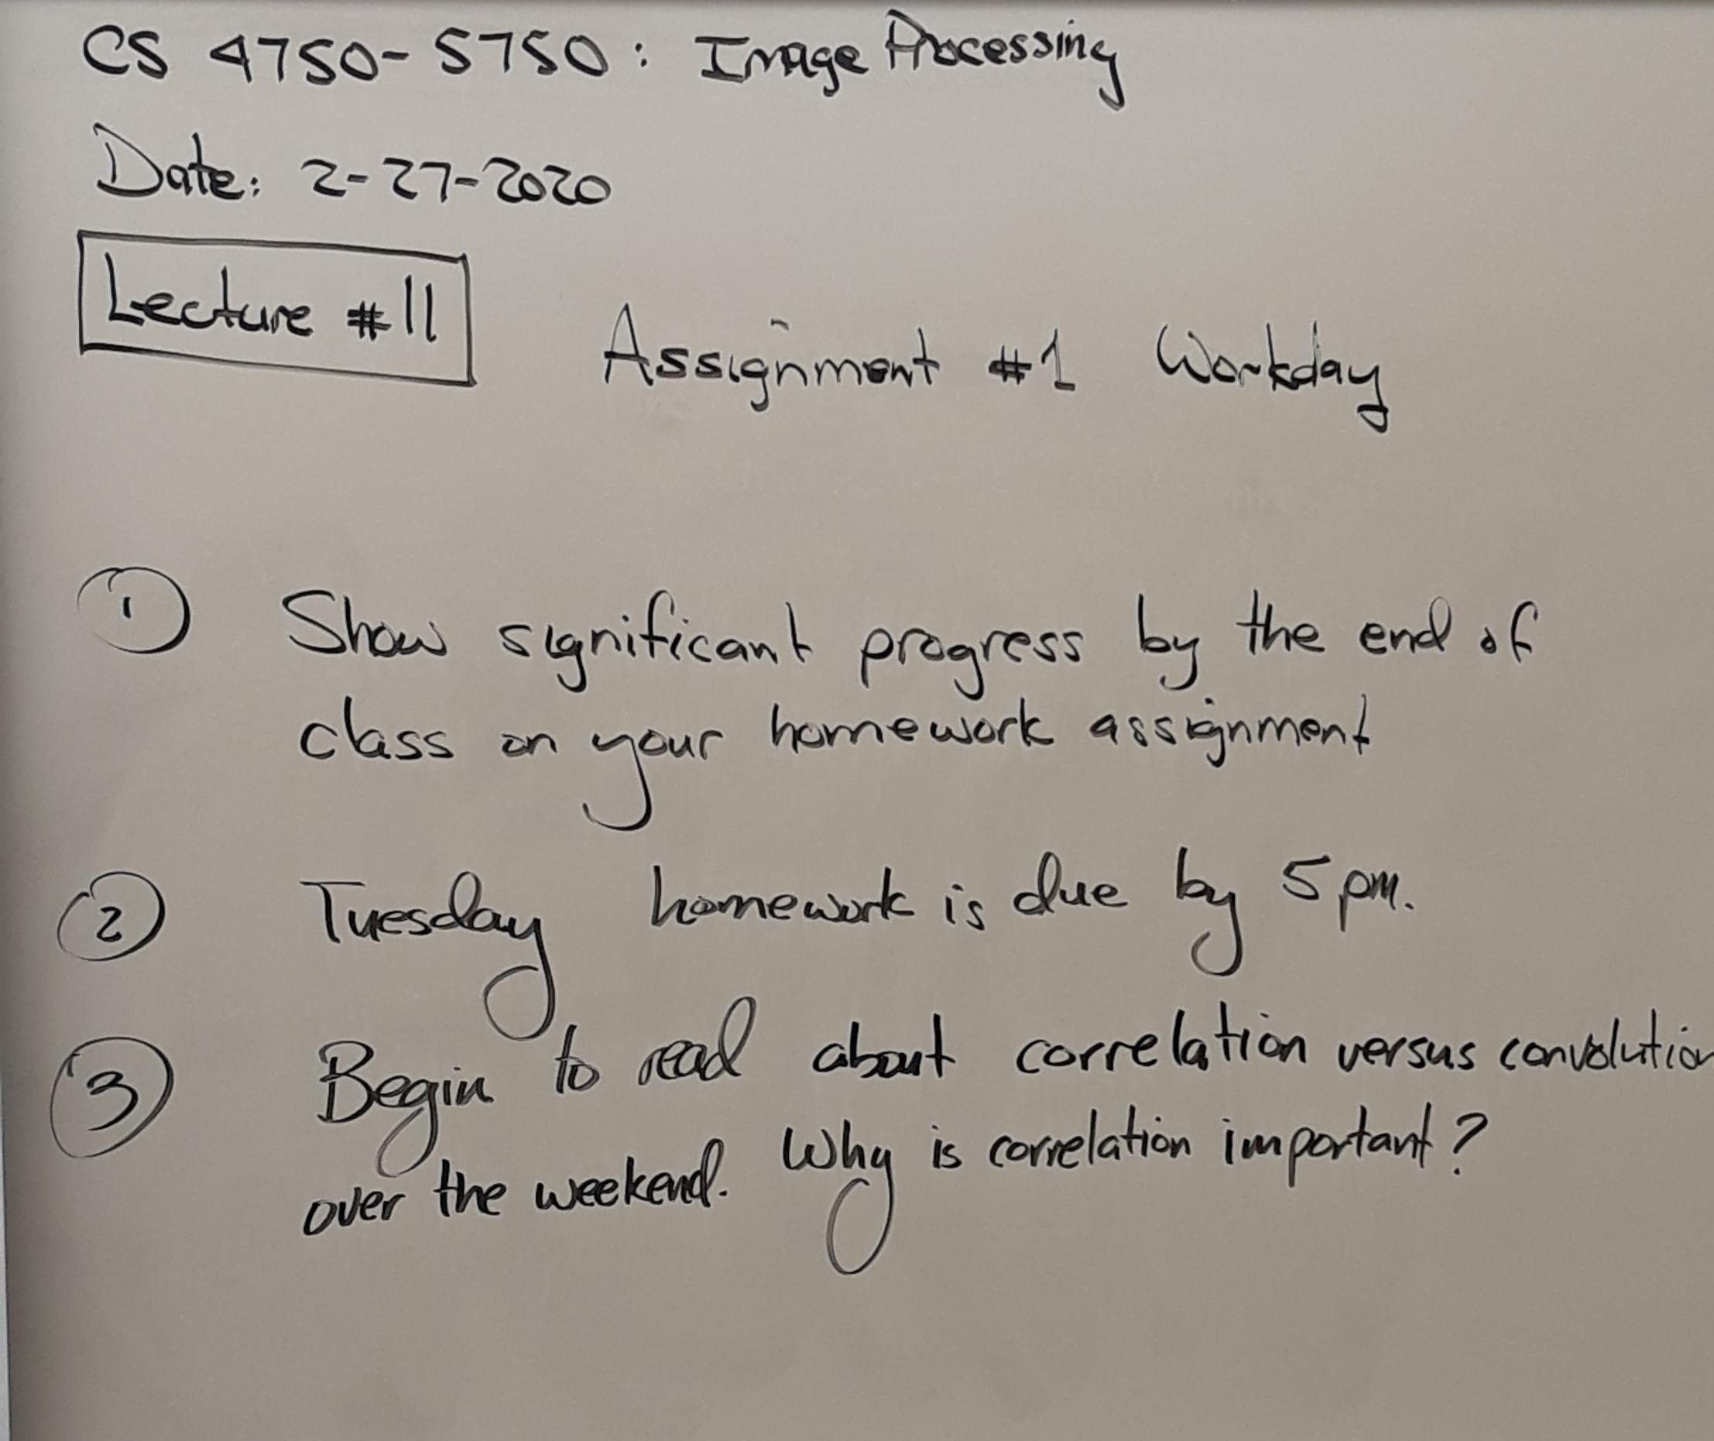
Lecture #11 - 02/27/2020

Slide 26
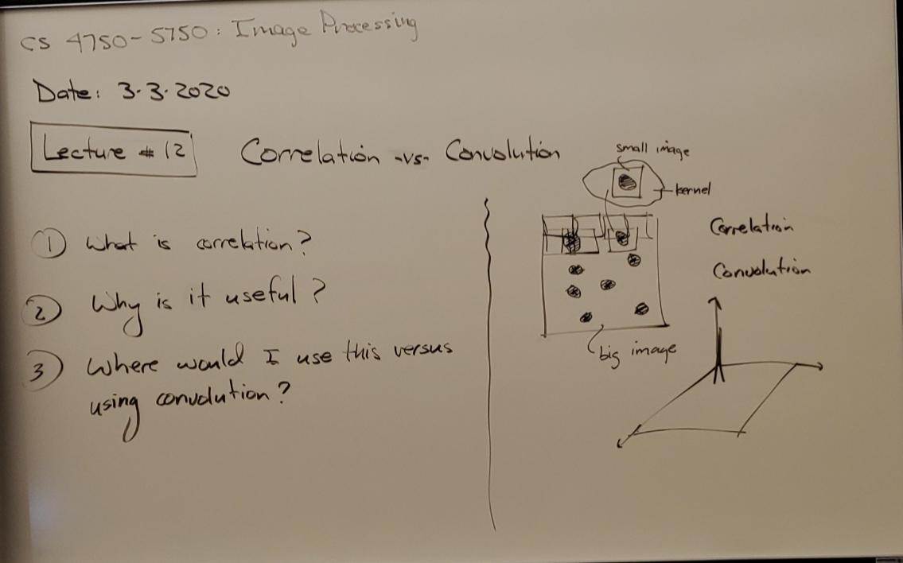
Lecutre #12 - 03/03/2020

Slide 27
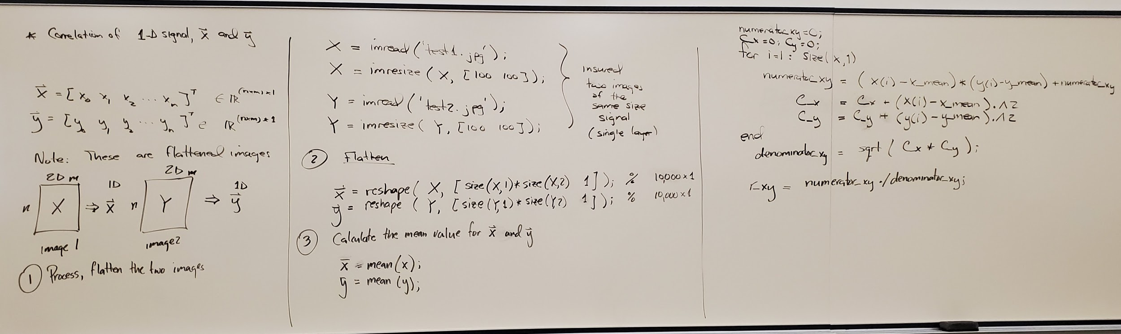
Lecture #12 - Part 2

Slide 28
Lecture #13 - 03/05/2020
Work Day

Slide 29
Lecture #14 - 04/02/2020
Videos covered in class:
https://www.youtube.com/watch?v=lmvO0vrAVIA
https://www.youtube.com/watch?v=vtjh_3_HSHI&feature=youtu.be
Please watch below for next class:
https://www.youtube.com/watch?v=AvPpaXejObo&feature=youtu.be

Slide 30
04/07/2020 - 04/09/2020
Use video from:
9 Frequency Domain 2d Images (Image Processing Using GNU Octave A MATLAB Compatible Software )
For 04/14:
Try to smooth outputted image from filtering
Try to have concentric circle for filter, populating it similar to gradient
Try to have box in center of filter

Slide 31
04/14/2020
Video watched in class:
CIS531: Gabor Filters and Wavelets on Images

Slide 32
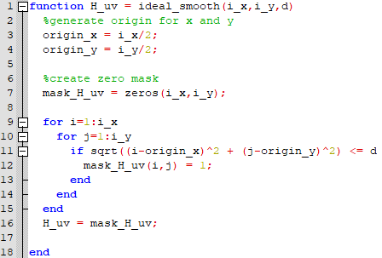
04/14/2020 - contd.

Slide 33
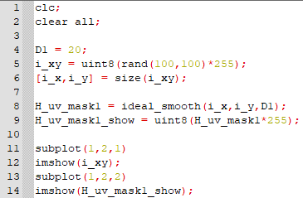
04/14/2020 - contd.

Slide 34
04/16/2020
Video covered in class:
“How the 2D FFT works” (click to reach video)

Slide 35
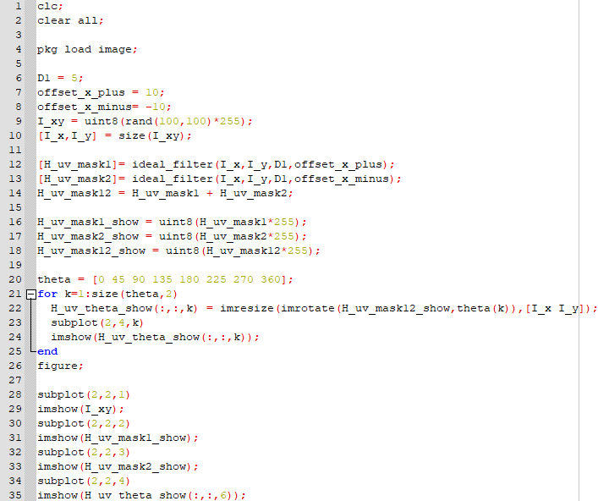
04/16/2020 - contd.

